Slide 1
Mobile Technology
(Joining the Smartphone Revolution)
Todd Althouse – Beacon Software
www.dispatchanywhere.com
866-437-6653

Slide 2


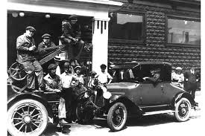

The Way it Used to Be
Notes:
Calls came in through switchboard

Slide 3
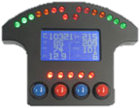
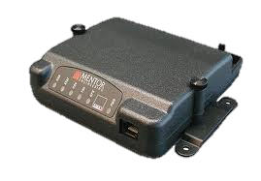
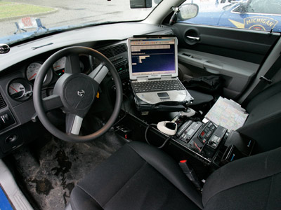
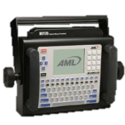
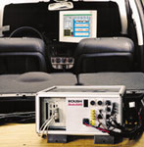
Expensive Proprietary Solutions
Notes:
Tell story of first Engineering job out of college – developing system inventorying signs while driving

Slide 4
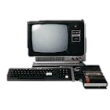
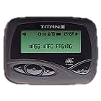
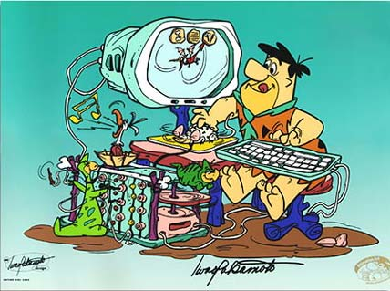

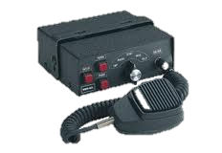
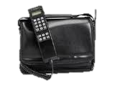
Technology is quickly outdated
Notes:
Some of you may still be using some of this equipment – ask them to raise their hands

Slide 5
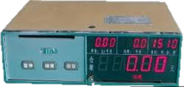

Before 2011
Proprietary Solutions cost thousands of dollars
They only worked on specific hardware
They were outdated and no spare parts available
Problematic at best
Notes:
Ask if anyone has a proprietary system. Such as an old GPS system
Tell MG Story about it always breaking down

Slide 6

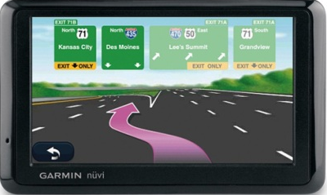
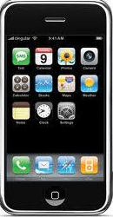
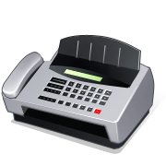
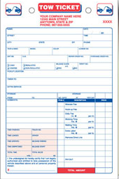

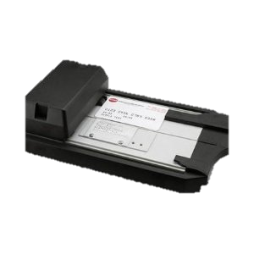
Welcome to 2011
=
Notes:
Everything is being done or soon will be

Slide 7
2 Important things to remember about technology
  It will be outdated in 6 months or less
  It will fail at some point and replacement parts may or may not be available
  If it ain’t broke don’t fix it – Is not the best philosophy when it comes to technology!!!!
Notes:
Had anyone had something fail only to find out parts are not available
If

Slide 8
What to do
Choose technologies that will grow with your business
Choose a solution that allows you to get newer hardware as it becomes available
Choose hardware that is inexpensive and easily replaced when lost, broken or worn out.
Smart Phones and Tablets can do all 3

Slide 9
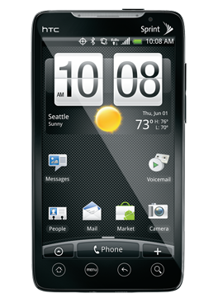
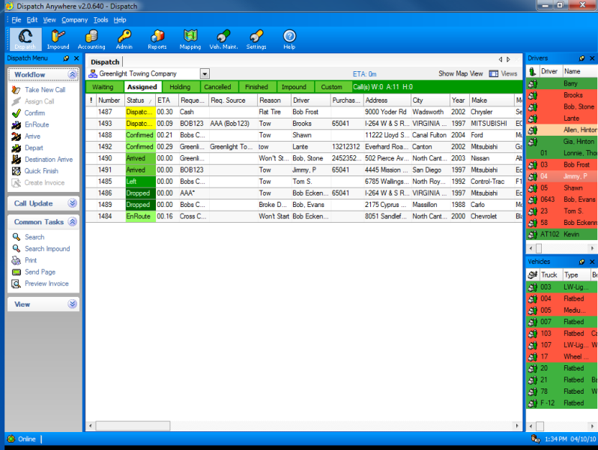
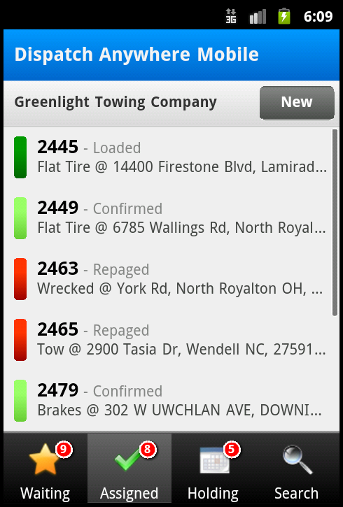
Mobile Dispatching
=

Slide 10
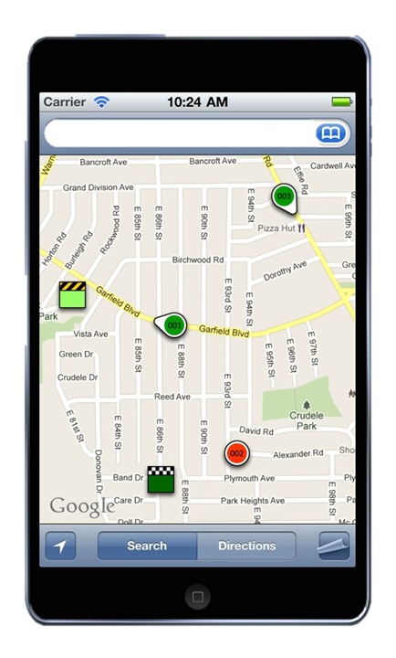
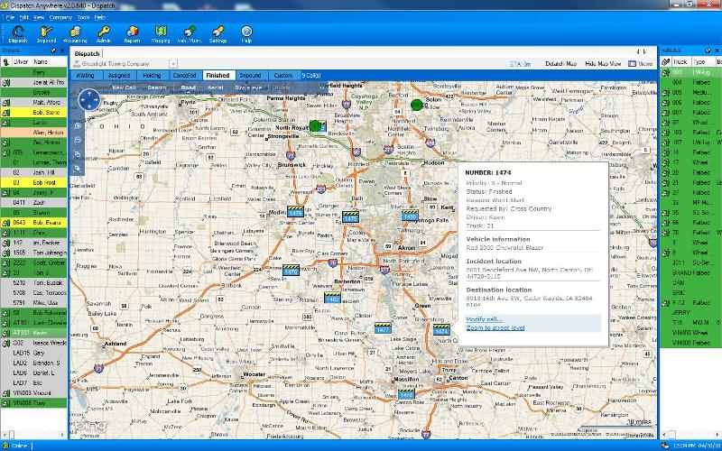
Mobile Dispatch GPS Tracking
=

Slide 11
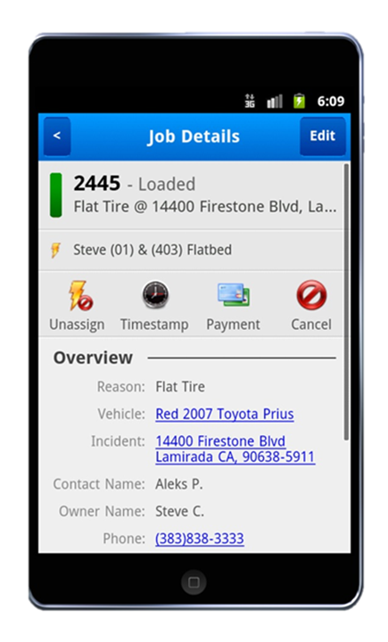
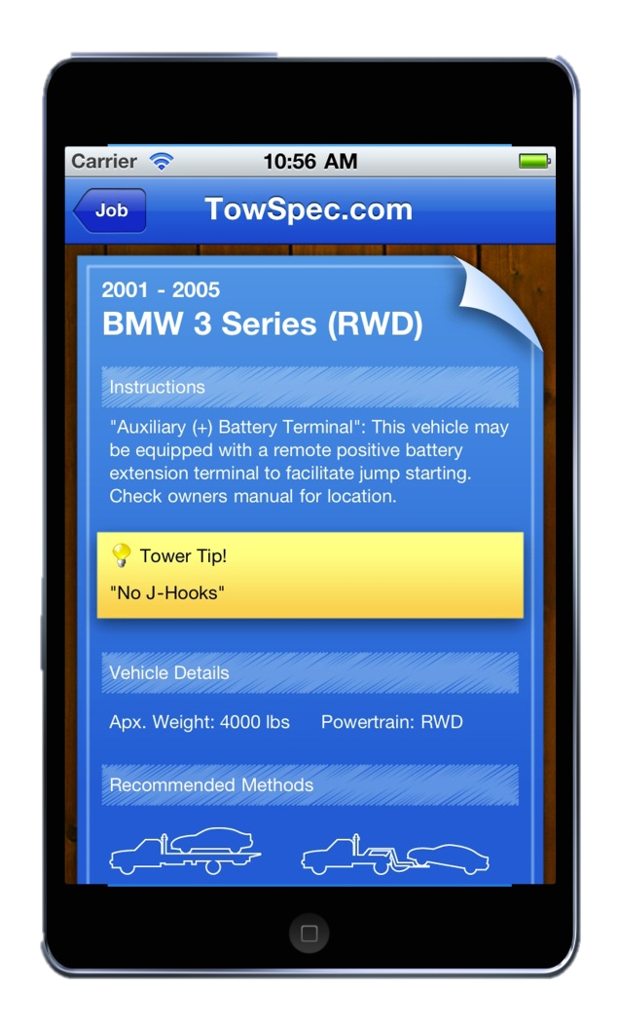
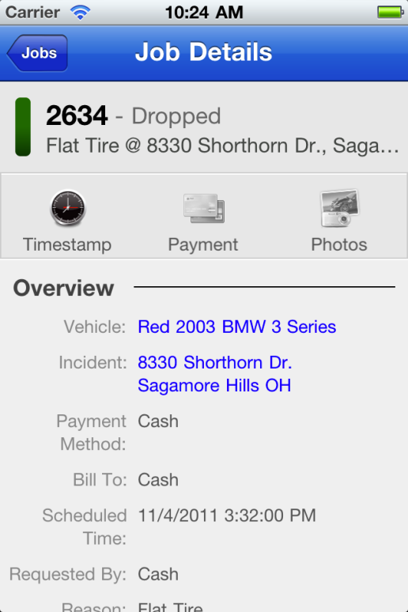
Mobile Call Details and TowSpec

Slide 12
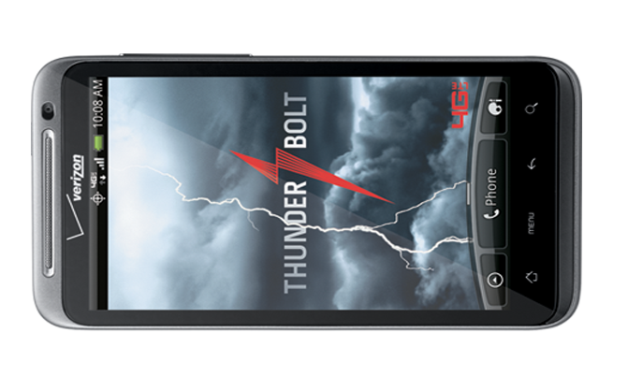
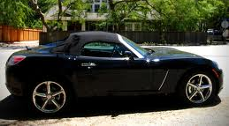
Take photos before you tow

Slide 13
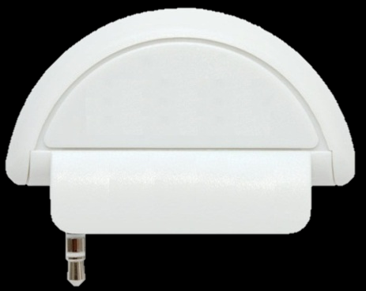
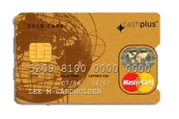
Mobile Credit Card

Slide 14
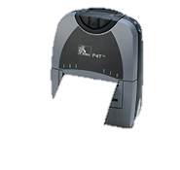
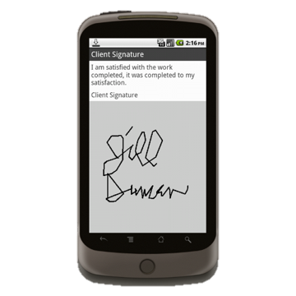
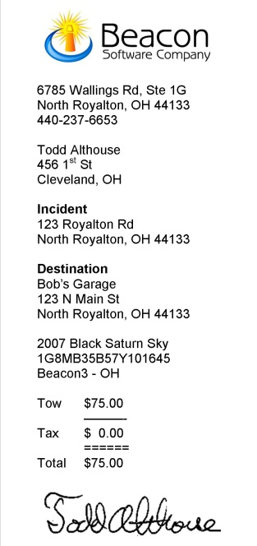
Signature Capture and Receipt Printing

Slide 15
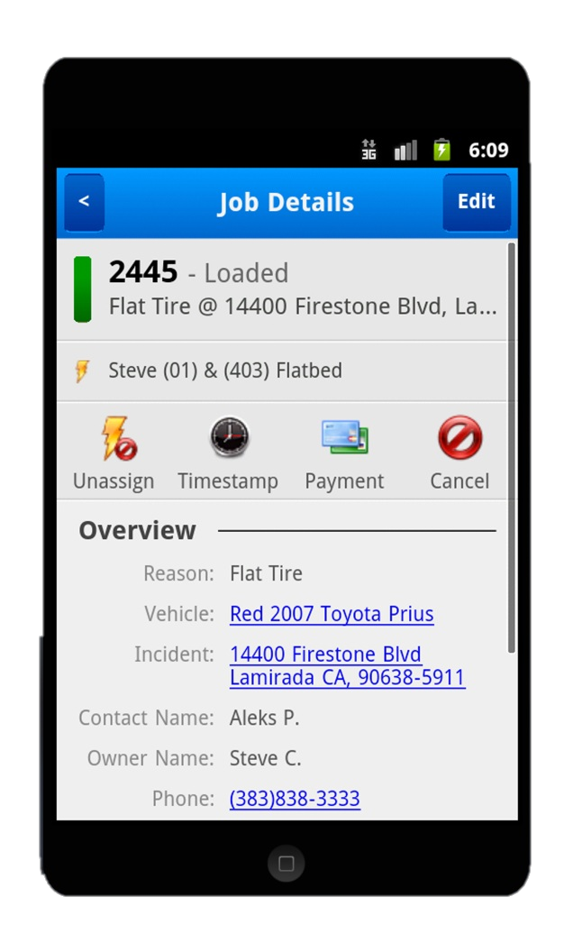
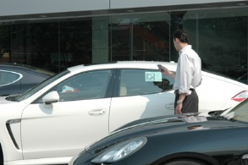

Bar Code Scanning???

Slide 16
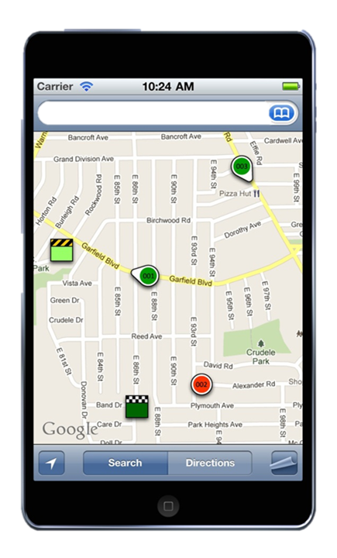
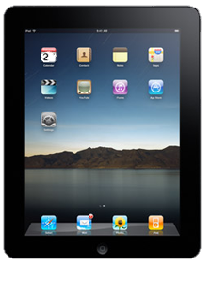

Works on Smartphones and Tablets
Beta testing NOW on IPhone, IPad,
Android (phones and tablets)
Blackberry and Windows 7 – Early 2012
Notes:
Send invoices to a fax machine from your phone.

Slide 17
Live Demos
(DispatchAnywhere Mobile Driver)

Slide 18
Conclusions
There will be 450 million smartphone sold in this year. They expect nearly 631 million per year by 2015.
There will be 10 million tablets sold this year and 50 million expected in 2012
The cost is going to continue to come down. So the smartphone and tablets will definitely become part of our everyday lives.
Please stop by the BEACON SOFTWARE booth to see smartphone and tablet demos
www.dispatchanywhere.com

