Slide 1
Automating Motor Club Billing
Presented
by
Beacon Software, LLC
Todd Althouse
Robert Eckenrode
866-437-6653
www.dispatchanywhere.com

Slide 2
Facts
Motor Clubs expect about 15% of all calls to never be billed by the service provider.
Using towing management software greatly reduces this number
Motor Clubs also know that not all service providers request GOAs when they are allowed.
Using towing management software greatly reduces this number
Traditionally the Service Provider has been expected to do all the work to get paid (i.e. input all the calls on the Club’s billing site or send in copies of invoices).
One towing software product – Dispatch Anywhere ‘s Automated Motor Club billing module from Beacon Software can greatly reduce the effort required to bill these calls.

Slide 3
Cross Country’s Service Provider Portal - Argosi

Slide 4
Everyone has seen this page before – for better or worse this is what you have done (according to the Motor Club).
Most clubs use your historical performance as one of several factors to determine which provider should get the next call.
There are ways to improve your numbers – we can talk about that at the end of this seminar.

Slide 5
This the Argosi’s Online Submittal screen.

Slide 6
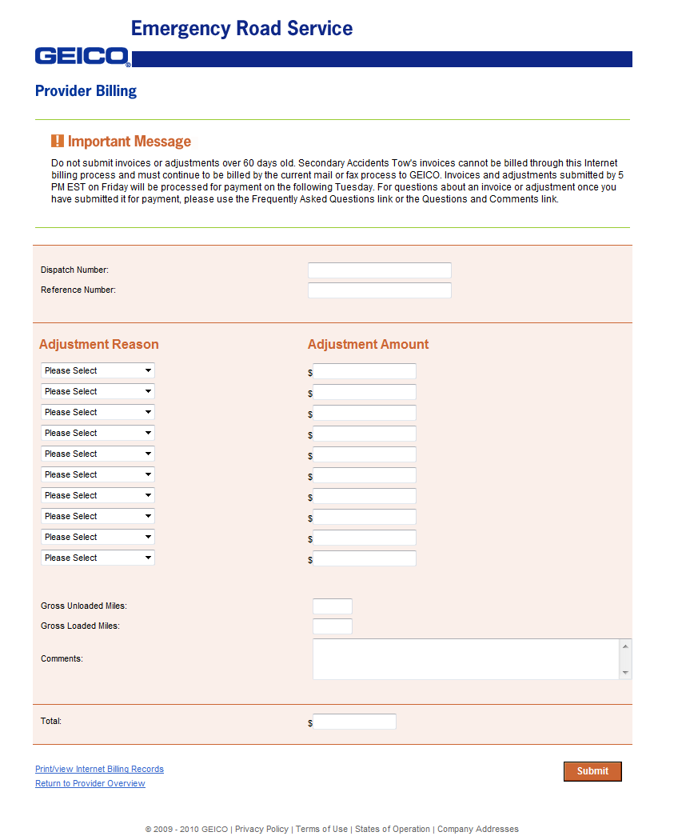
Geico’s Online Submittal screen USAC’s Online Submittal screen

Slide 7
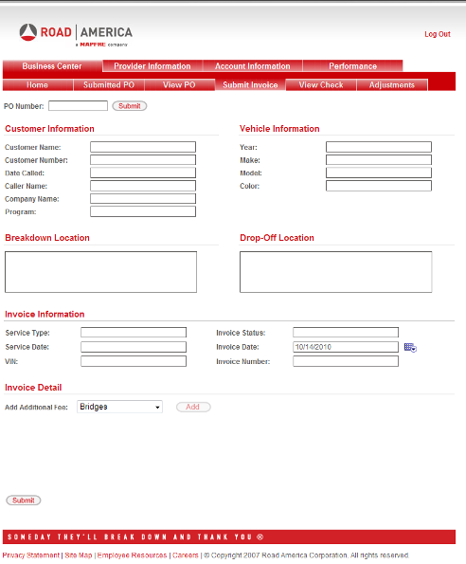
Road America’s Online Submittal screen Allstate’s Online Submittal screen

Slide 8
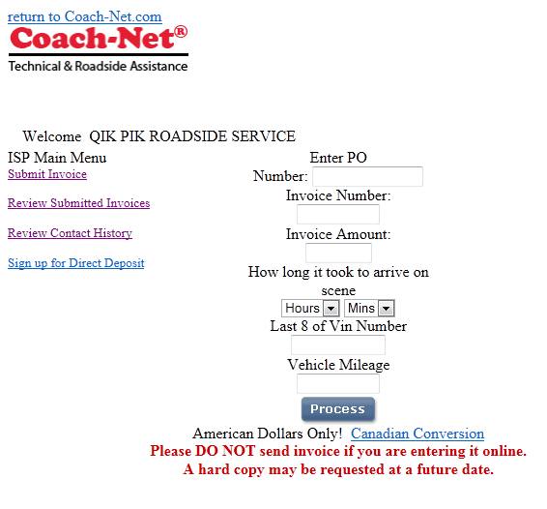
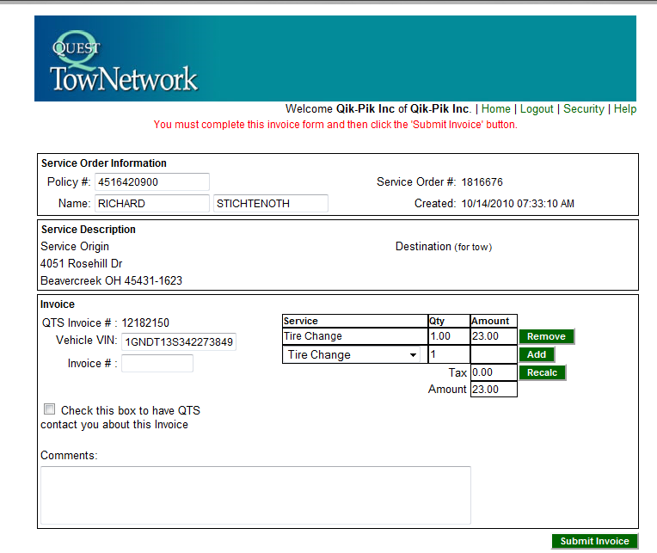
Coach-Net’s Online Submittal screen Quest’s Online Submittal screen

Slide 9
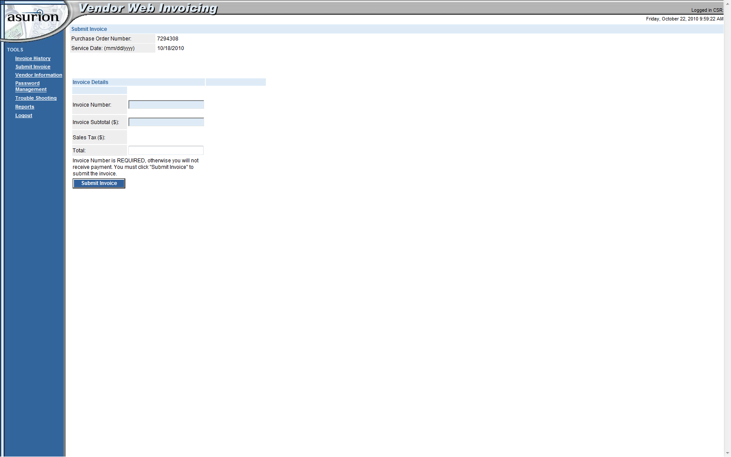
Asurion’s Online Submittal screen

Slide 10
Manual Submittal Facts
A person can submit an average of 1 call per minute – at BEST
Most companies do not have time to submit invoices immediately or even the same day as the call was completed. I have seen this lag as much as 2 weeks behind.
The faster the invoice is submitted the faster you are paid

Slide 11
Manual Submittal Costs
Let’s take a company that averages 50 motor club calls per day:
Assume they do billing every 3 days for 3 hours – that is 30 hours per month.
So if a person is paid $12 per hour plus taxes, that person costs the company about $15/hour * 30 hrs/mo * 12 mo = $5400 per year.
For some companies this is the cost for only 1 club!

Slide 12
There is a better way!!!

Slide 13
Beacon’s Automated Motor Club billing screen in Dispatch Anywhere.
These calls are ready to submit to a Motor Club’s Website. The calls are submitted to each club’s website automatically and in the background.
Notes:
Notice the ones marked with EDIT. I will talk about those in a few minutes.

Slide 14
All calls were successfully submitted in less than 2 minutes

Slide 15
If there is missing or incorrect information for a call, the Motor Club Billing system will prompt the user to correct the call. This insures that all calls are billed 100% accurately.

Slide 16
Automatic Submittal Costs
Let’s assume the company already has our Dispatch Anywhere product.
We can talk after the seminar why the other features of the product will save you more than the cost of the product.
Using that same 50 Motor Club call per day company:
The Automatic Motor Club billing module can submit about 15 calls per minute, so it takes about 3 minutes to bill those 50 calls.
They now do billing at the end of every day for 3 minutes – that is 90 minutes per month. A far cry from 30 hours (1800 minutes) per month ~ 95% time savings.
So if you pay an employee $12 per hour plus taxes, that person costs you about $15/hour * 1.5 hrs/mo * 12 mo = $270 per year.
The MC Billing Module for DispatchAnywhere will cost you about $300* per year. .
Total cost: $270 + $300 = $570 (Savings over Manual = $4830 ~ 90%)
* Based on 1 User Dispatch Anywhere System ($25/user/mo)

Slide 17
Conclusion
Using a Towing Management Software, such as Beacon’s Dispatch Anywhere will insure that 100% of Motor Club calls are billed.
Using Beacon’s Automated Motor Club Billing system is 15 times faster than manual methods ~ an 90% cost savings. Not to mention calls are billed 100% accurately. Now working with Asurion, Cross Country, Geico, Signature and USAC, Coach-Net, Quest and Road America. Allstate ????
So the combination of Towing Management Software, Digital Dispatch Software along with Automated Motor Club Billing will allow 1 person to do the work of 3.
www.dispatchanywhere.com
Main Exhibit Hall Booth 406
866-437-6653

