Slide 1
Beacon Software Company
www.dispatchanywhere.com
Booth 1032 in the Exhibit Hall
866-437-6653

Slide 2

New for Tow Expo 2010

Slide 3

Starting at $25/month

Slide 4
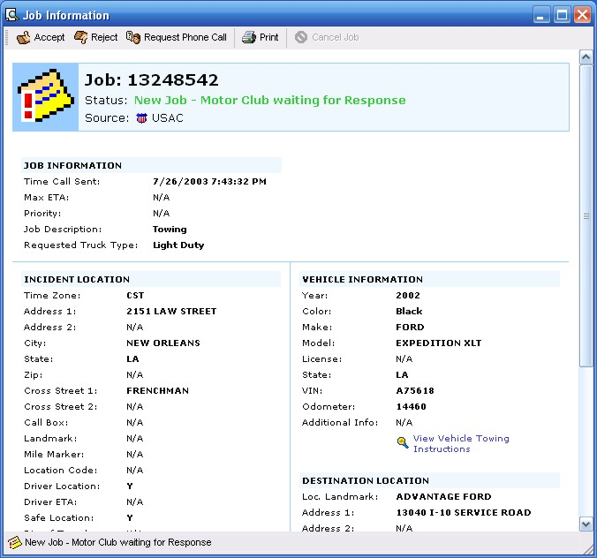
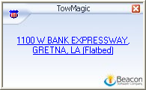
Incoming TowMagic Digital calls slide up from the bottom of the screen

Slide 5
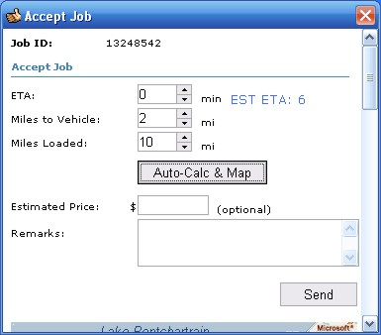
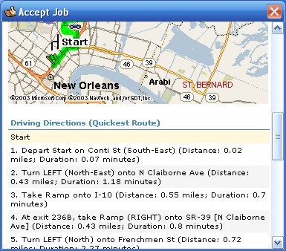
Click Accept job – input ETA and let system calculate mileages

Slide 6
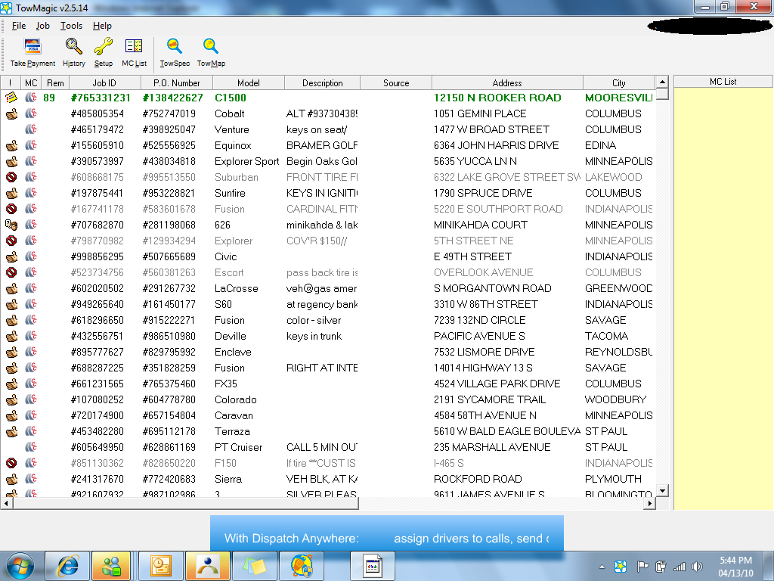
TowMagic digitally receives calls from AAA, Cross Country, Allstate, Signature, Geico, NSD, USAC and others

Slide 7
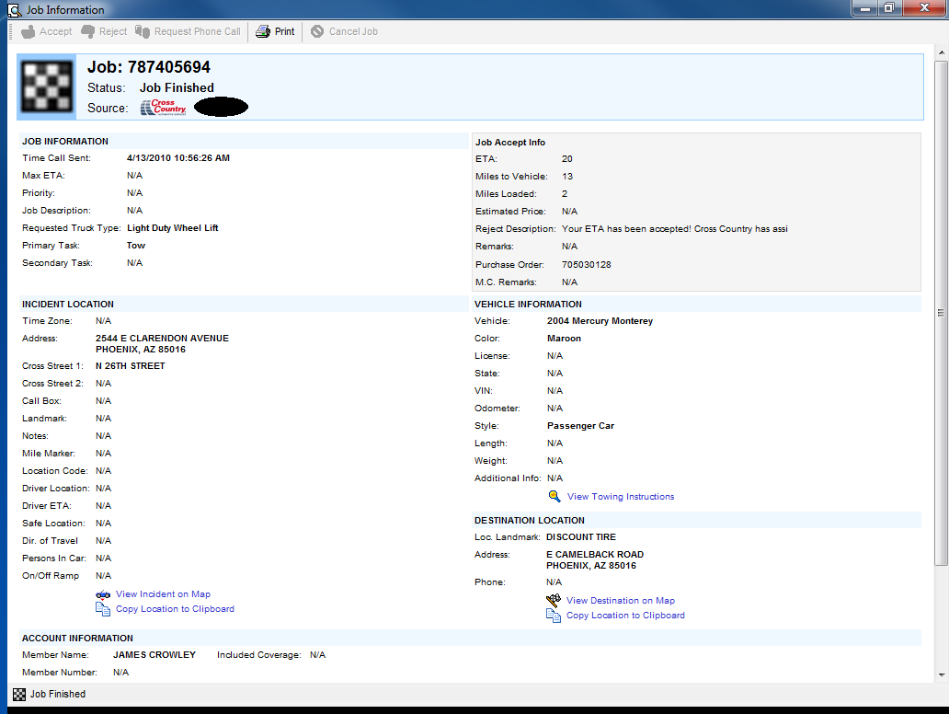
Job Information for a TowMagic call is displayed – then it is transferred automatically to Dispatch Anywhere to be sent to a driver via a text message

Slide 8
Dispatch Anywhere starts at $199 setup and $50/mo

Slide 9
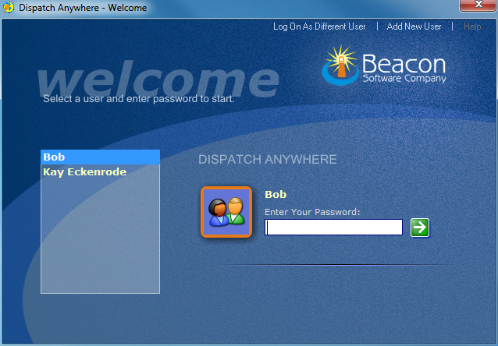
Dispatch Anywhere - Login Screen

Slide 10
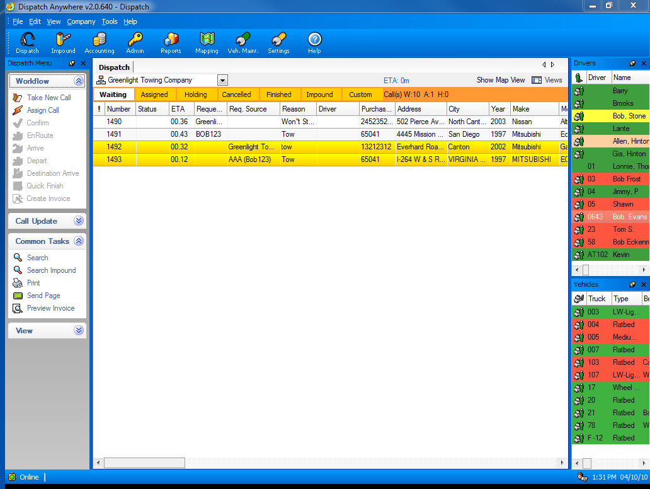
Dispatch Screen: Calls are digitally received from AAA, Asurion, Cross Country, Allstate, Signature, Geico, NSD, NAC, Coach-Net, Quest, Road America, USAC and your Customers

Slide 11
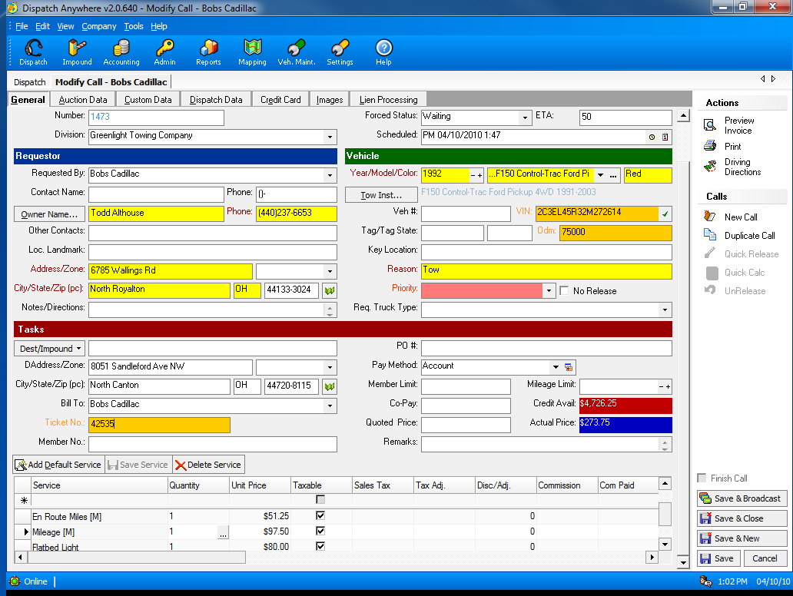
Call taking screen: Automatic Pricing, CC Processing, VIN Validation and TowSpec Towing Instructions

Slide 12
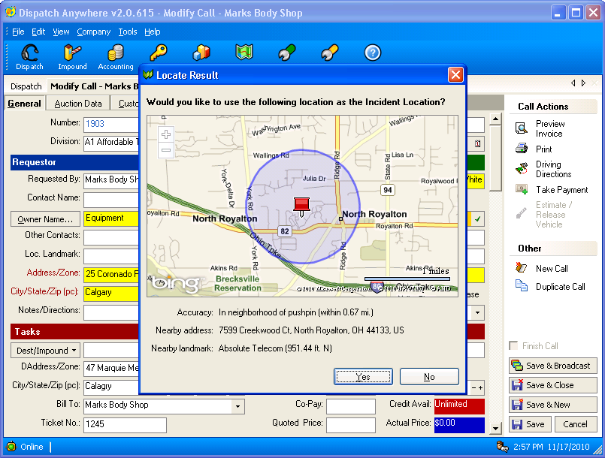
GPS Motorist Locator
Instantly retrieve a caller’s GPS location from the phone number

Slide 13
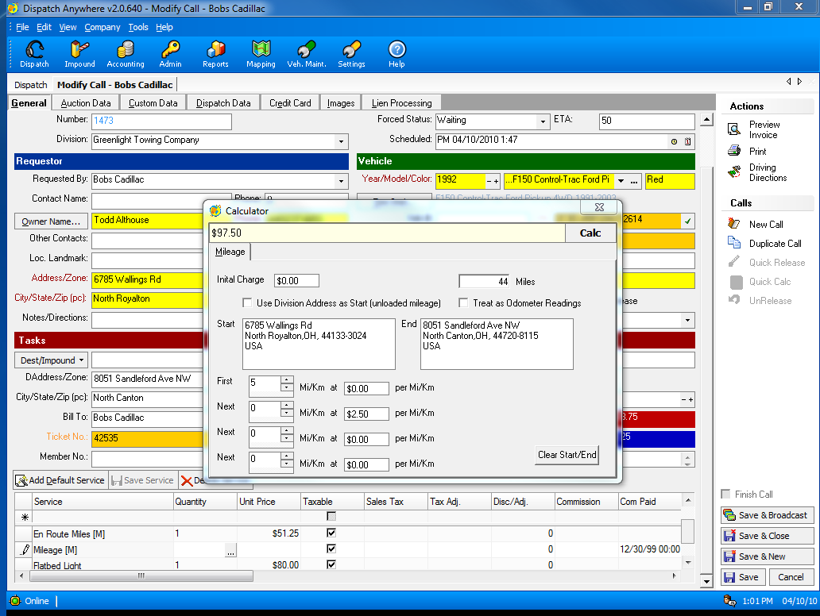
Built in Mileage Calculator

Slide 14
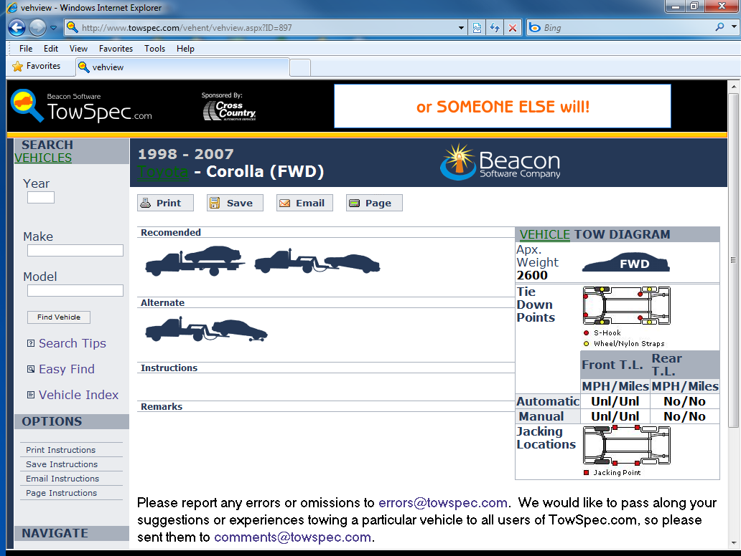
Integrated TowSpec Towing Instructions are just a click away

Slide 15
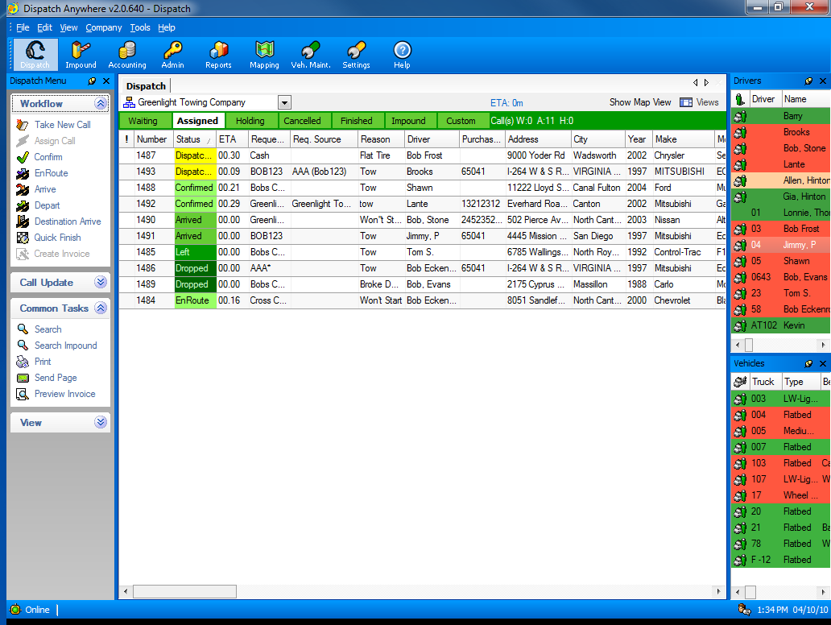
Main Dispatching Screen – status is automatically updated by driver via Pager, Cell Phone or in-vehicle MDT message

Slide 16
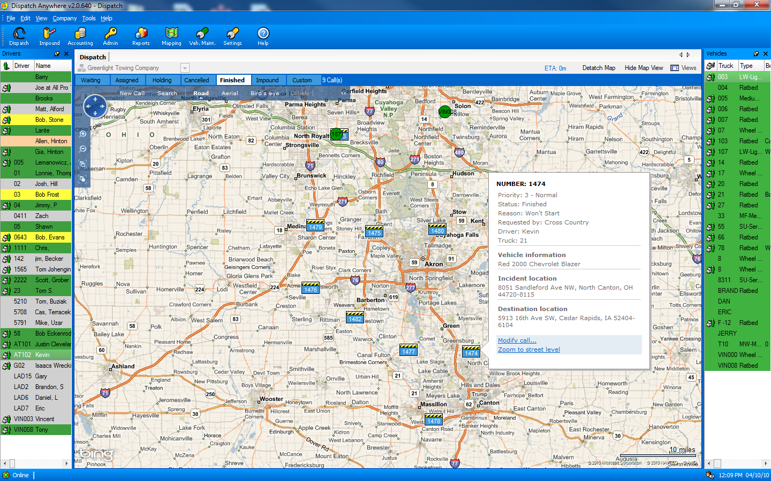
Dispatch Screen shown with Visual Dispatch and GPS integration

Slide 17
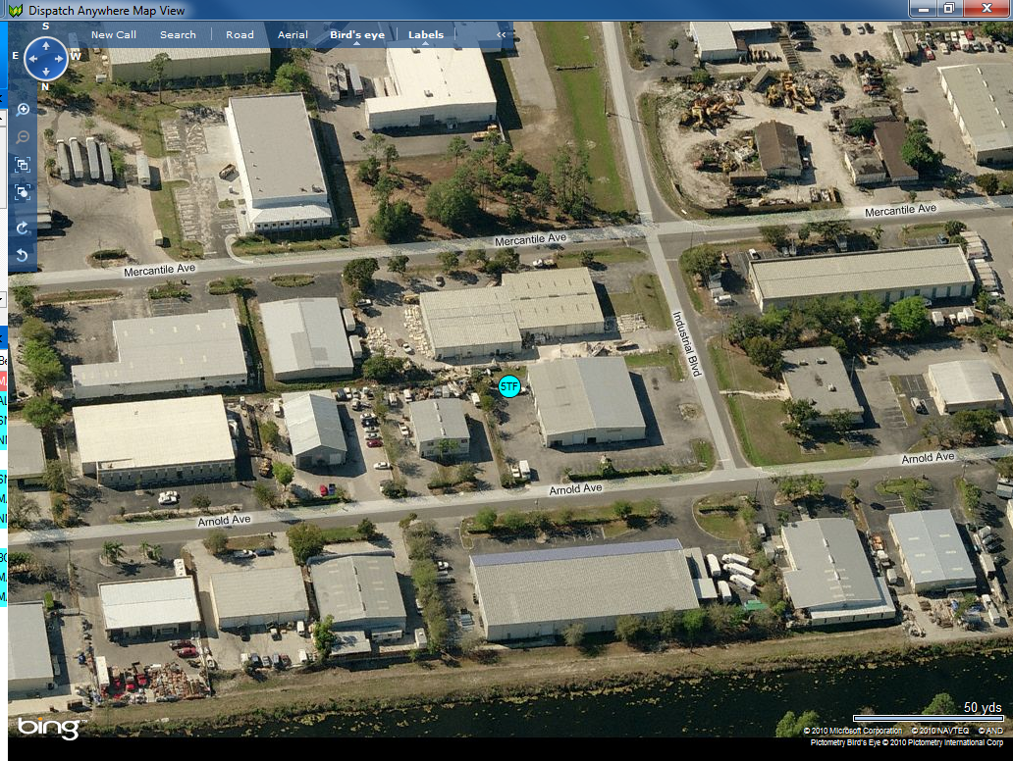
Mapping includes Bird’s Eye View - see the truck parked at shop.

Slide 18
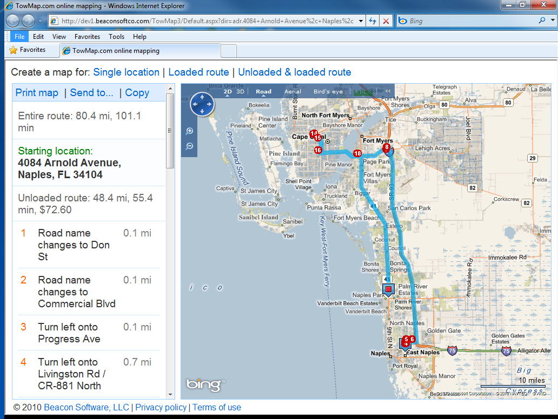
Integrated Driving Directions with Mileage calculations

Slide 19
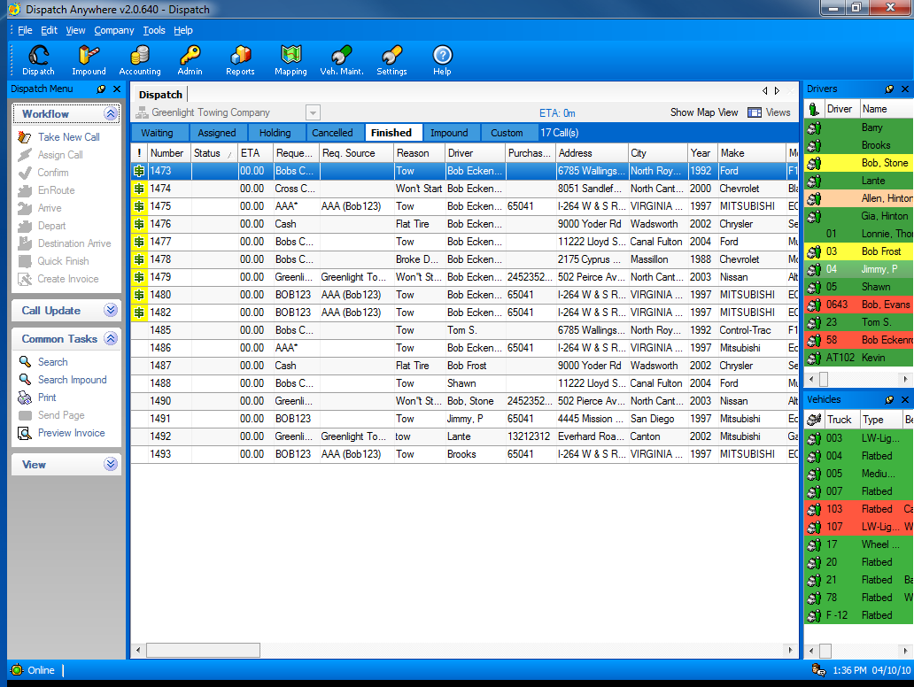
Calls are sent to Finished after clear time is received from a driver’s mobile device – pager, cell phone, or in-vehicle MDT

Slide 20
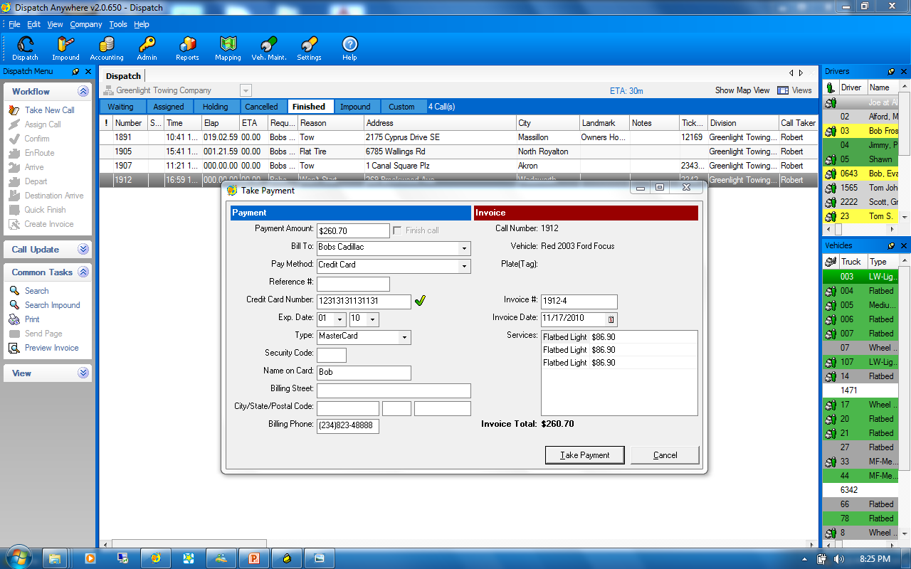
You may right-click to take a credit card payment at anytime.

Slide 21
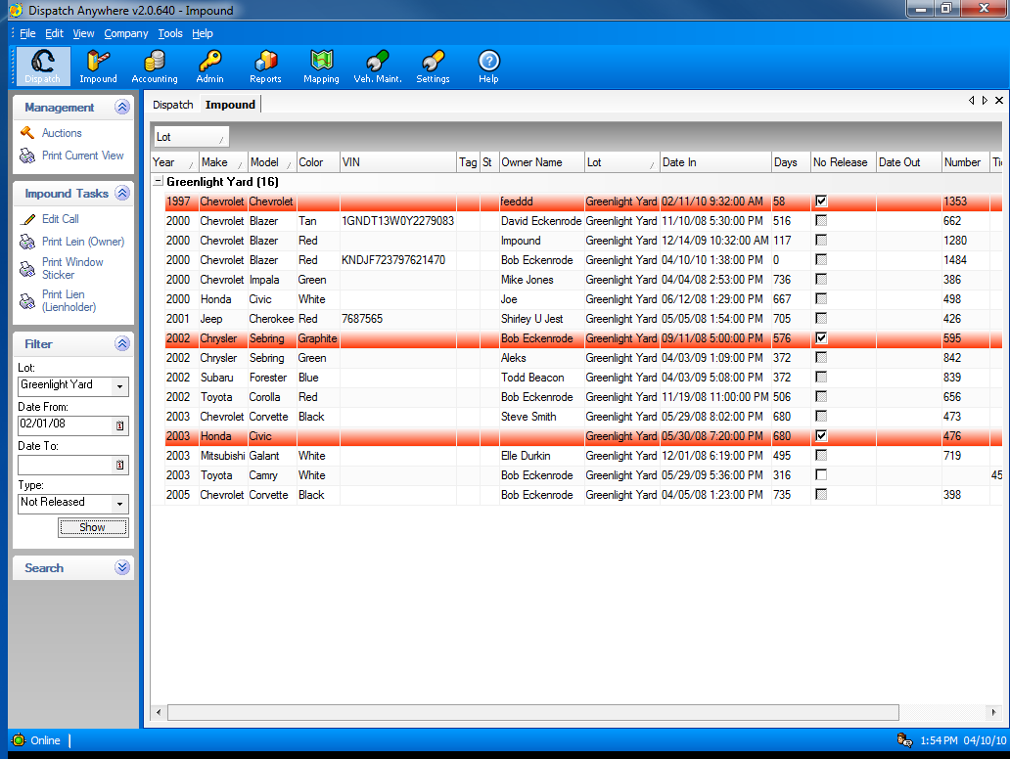
Complete Impound Lot Management

Slide 22
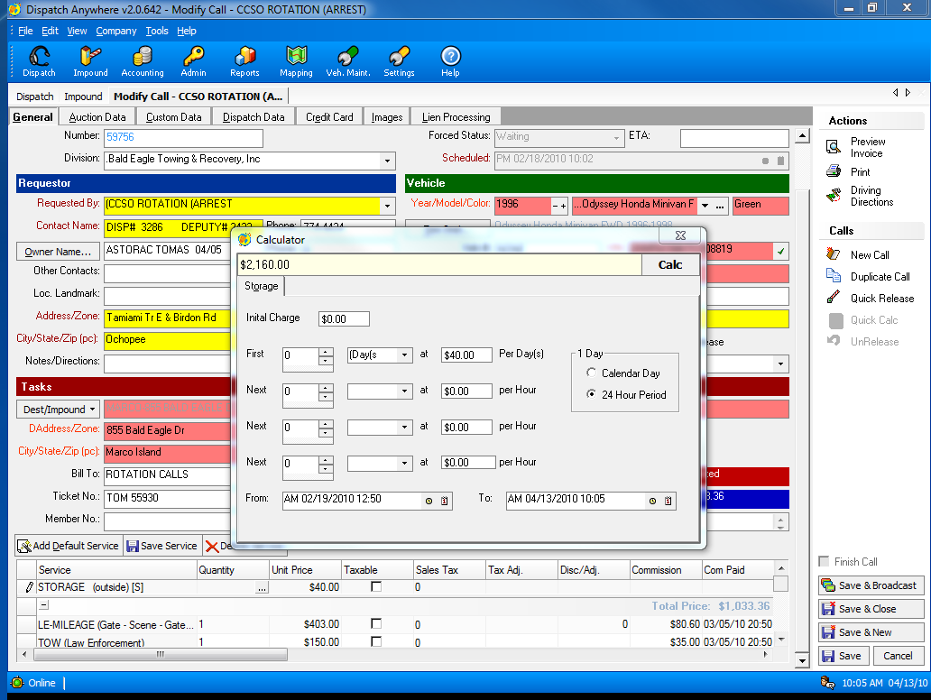
Integrated Storage Calculator configurable by account

Slide 23
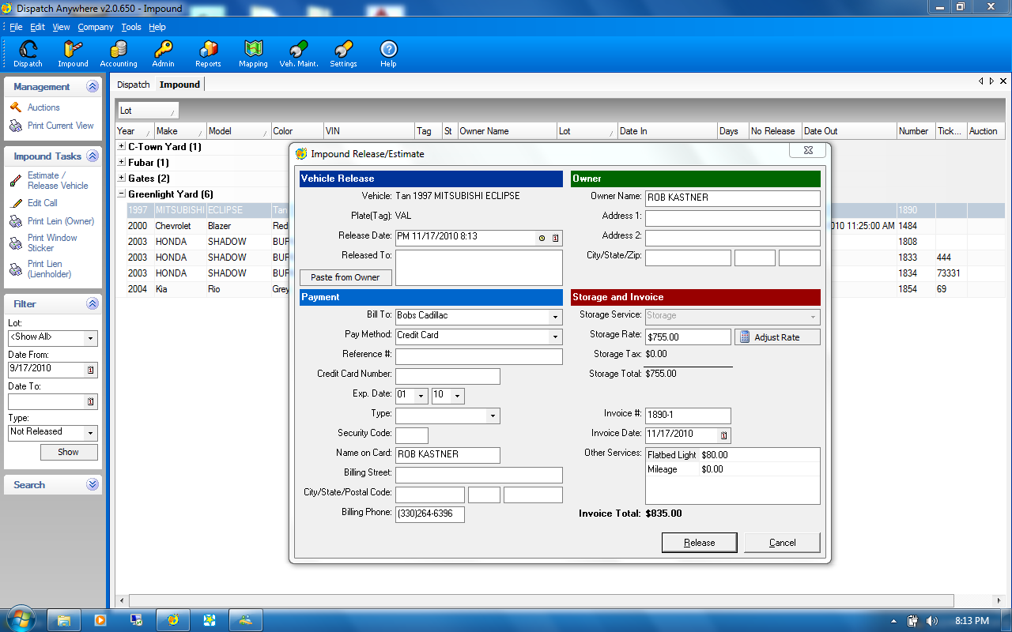
Easy vehicle release or estimate is available on a right-mouse click from the impound screen

Slide 24
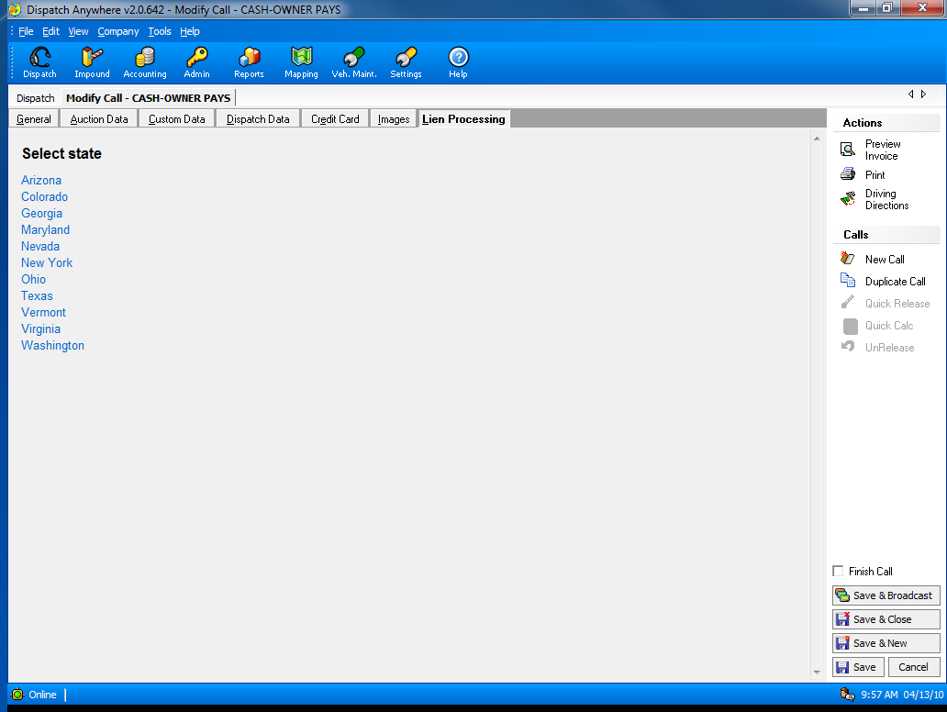
Built-in Lien Letters for many states
(FL, TX, MD, VA should use Towlien.com)

Slide 25
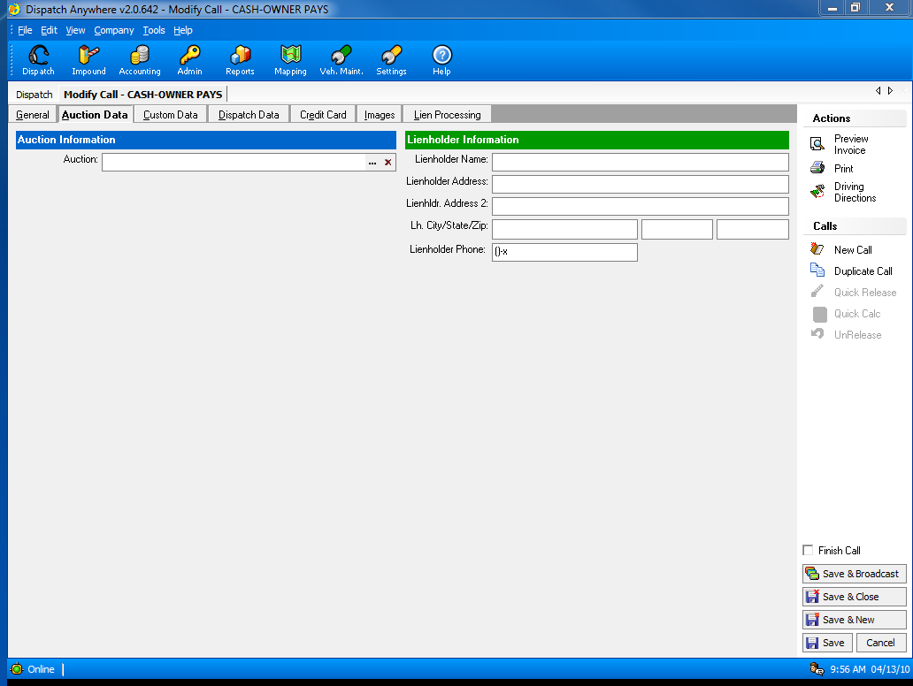
You can track cars for Auction

Slide 26
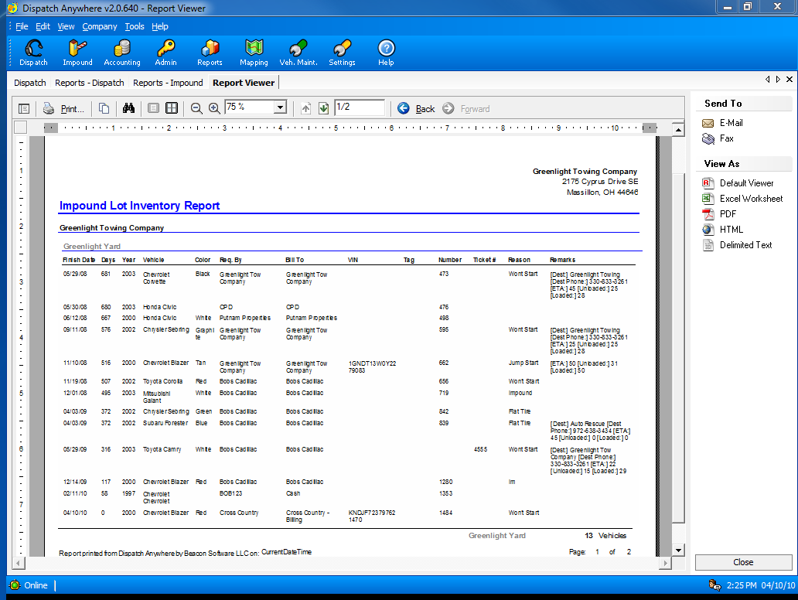
Impound Inventory Report

Slide 27
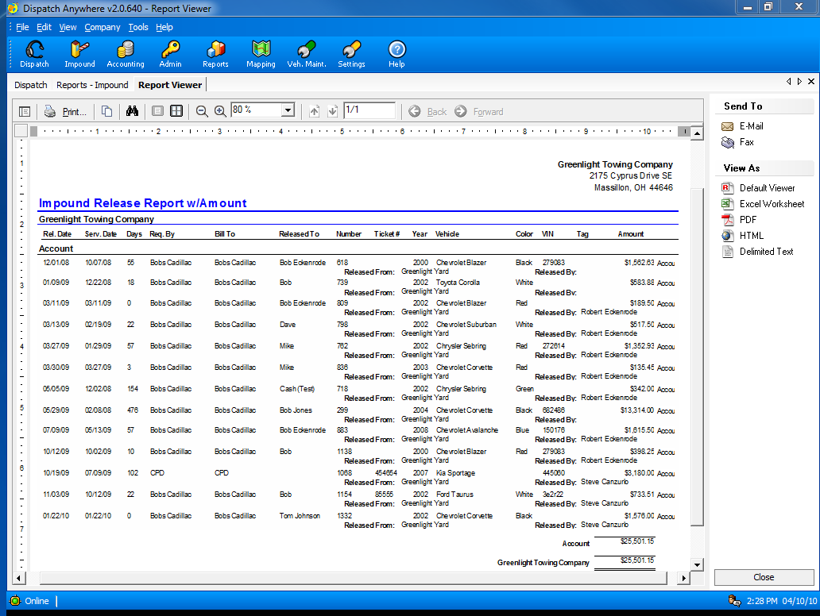
Impound Release Report

Slide 28
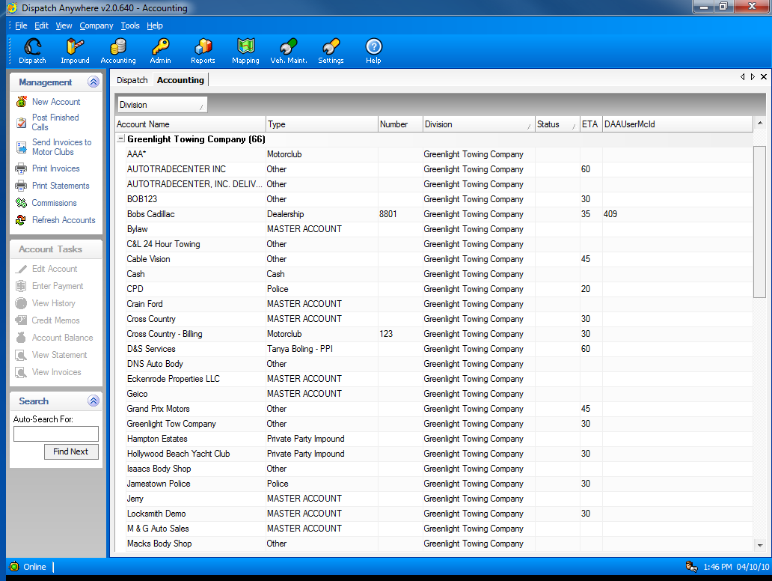
Complete built-in Accounts Receivable or Export invoices to QuickBooks

Slide 29
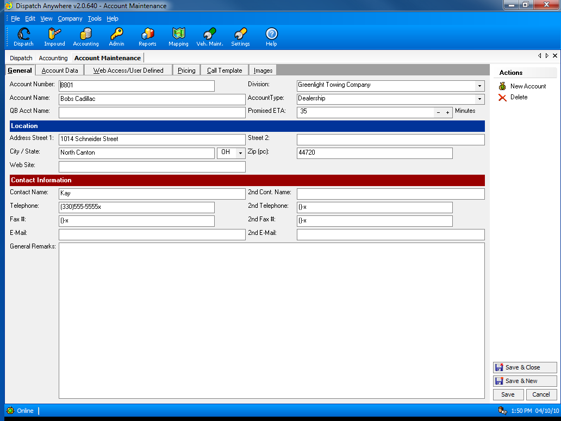
Account Configuration Screen

Slide 30
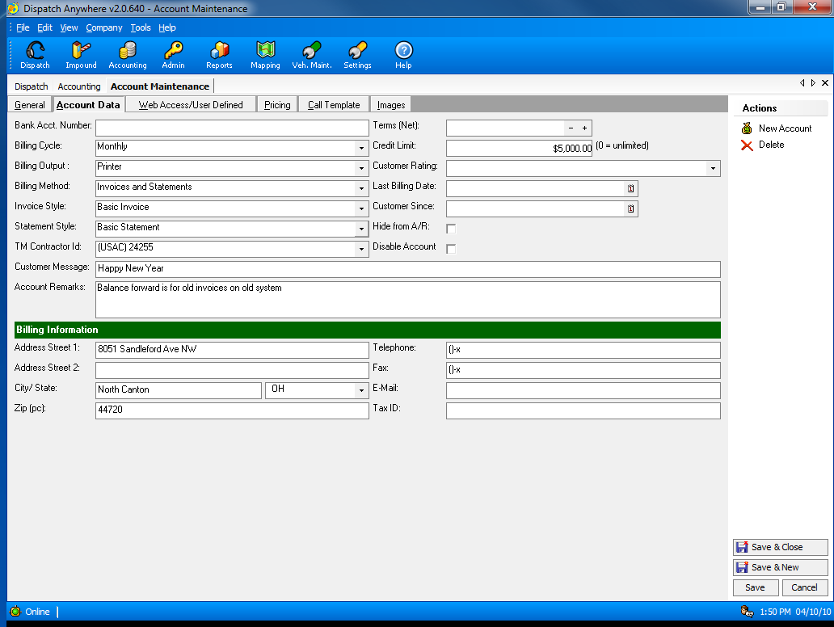
Ability to set Credit Limits by account

Slide 31
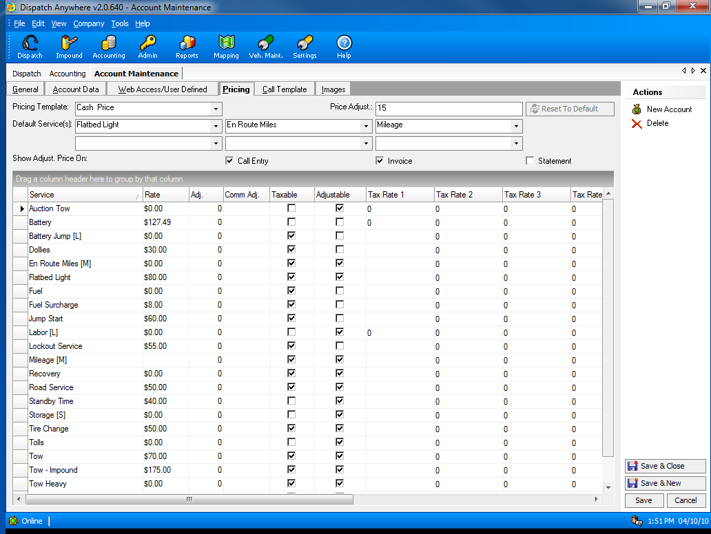
Complete pricing setup by account, so all calls will be automatically priced correctly.

Slide 32
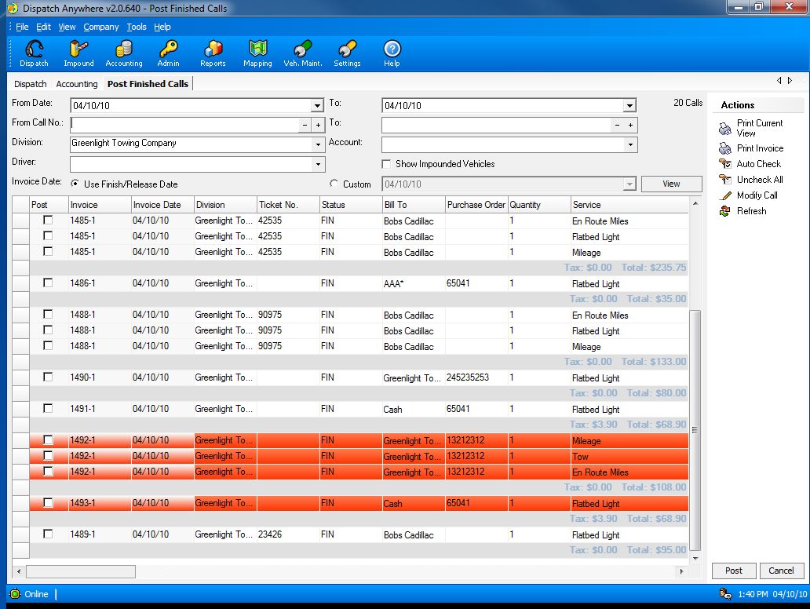
Verification of call charges is part of the complete integrated Accounts Receivable

Slide 33
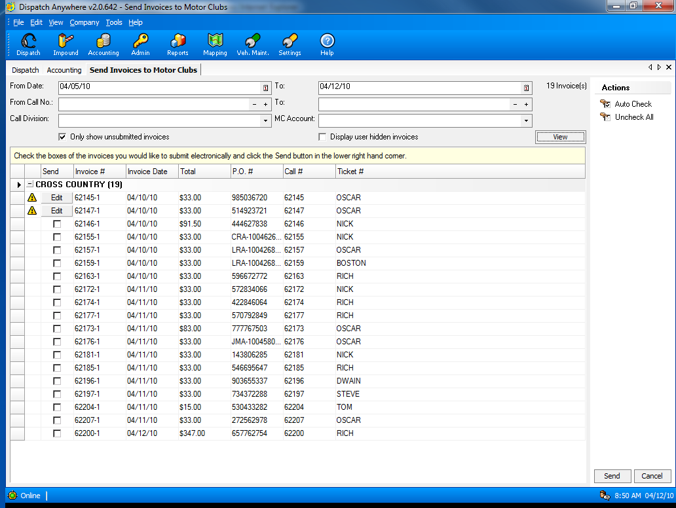
Automated Motor club Billing for Cross Country, USAC, Geico, Signature, Asurion, Allstate, Quest, Coach-Net, Road America – NO NEED for Argosi.

Slide 34
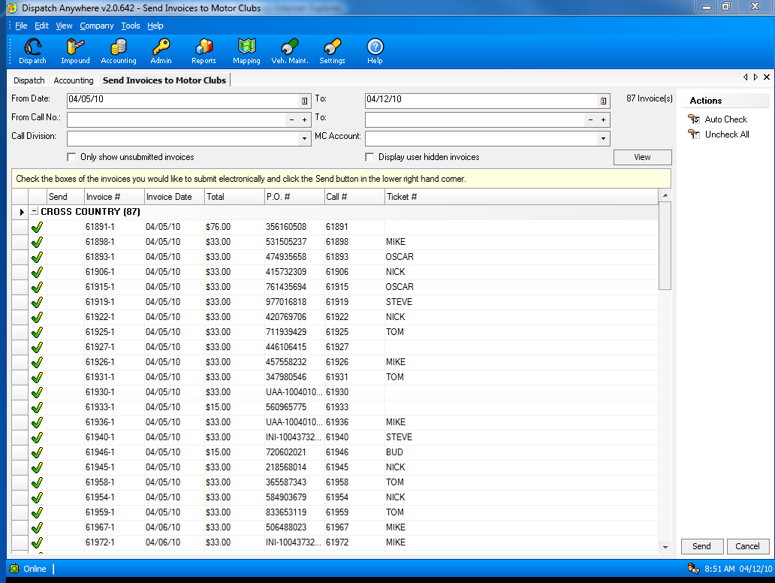
Calls successfully submitted to Cross Country – Argosi.
This process took less than 2 minutes for all calls shown.

Slide 35
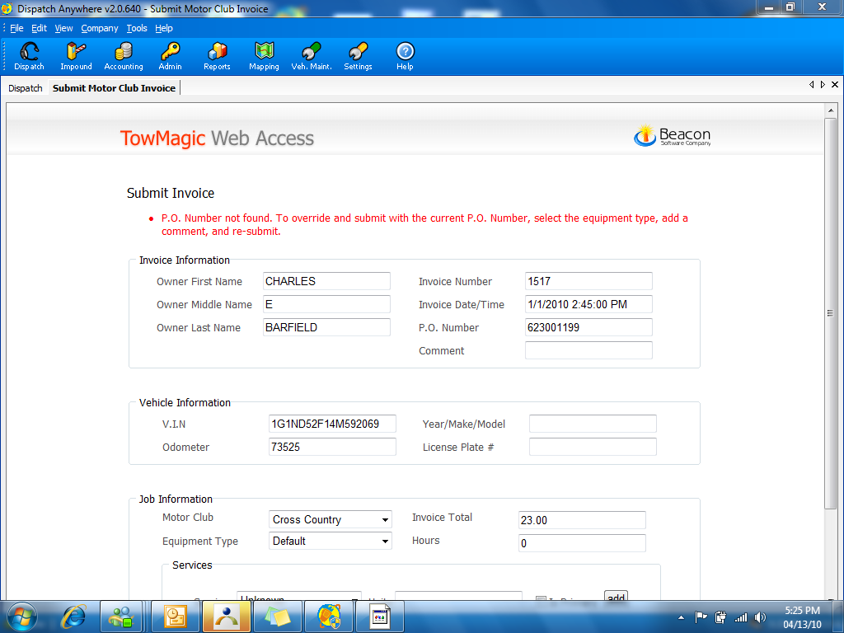
If there is missing or incorrect information for a call, the Motor Club Billing system will prompt the user to correct the call

Slide 36
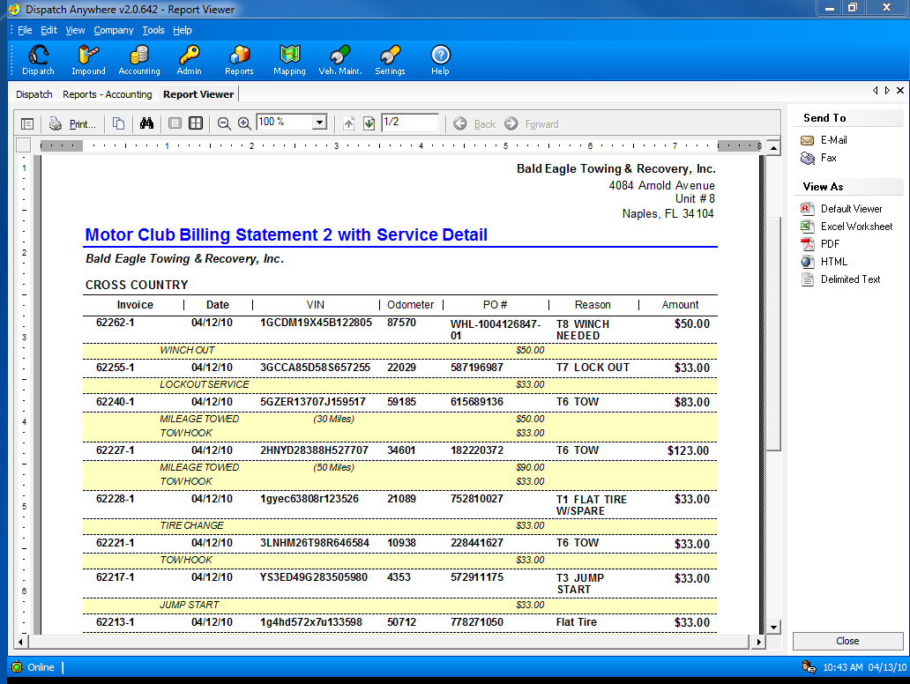
Bob’s Towing and Recovery, Inc.
Bob’s Towing and Recovery, Inc.
You may use this report for Allstate and others that do not have an online billing site so Dispatch Anywhere can do it automatically.

Slide 37
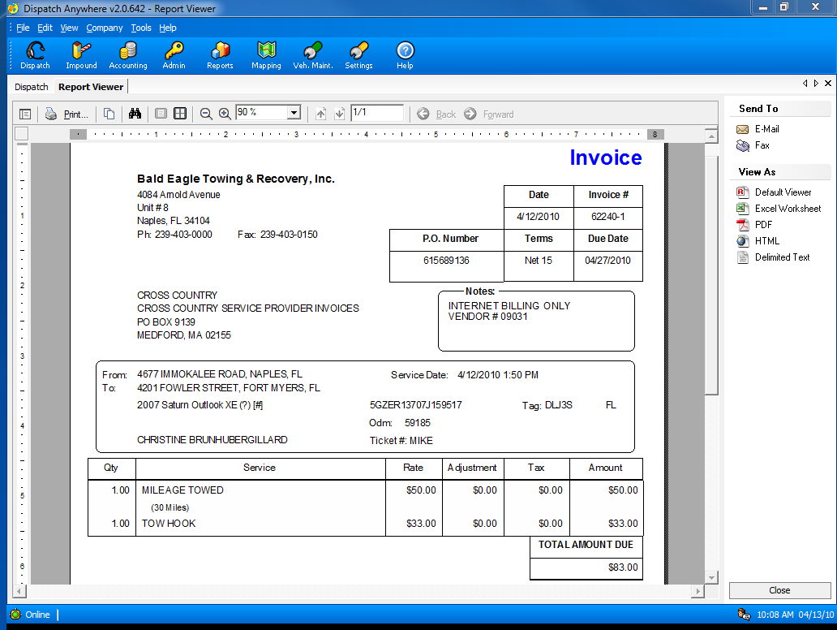
Bob’s Towing and Recovery, Inc.
Many built-in selectable Invoice Styles by account

Slide 38
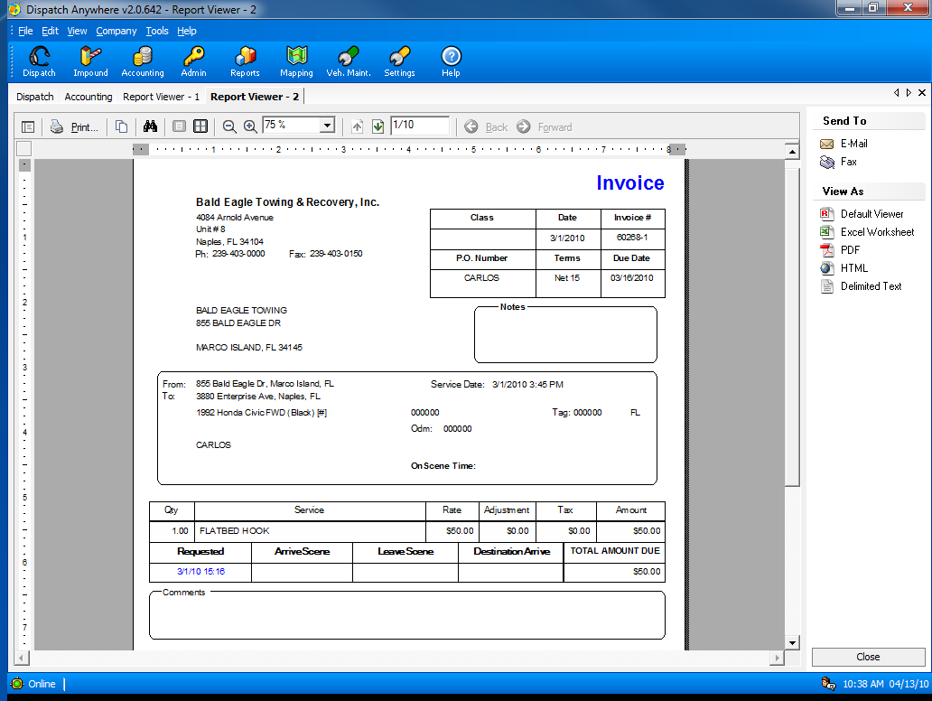
Bob’s Towing and Recovery, Inc.
Many built-in selectable Invoice Styles by account

Slide 39
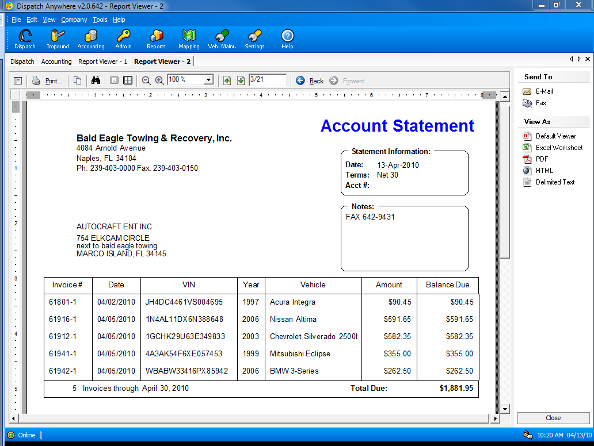
Bob’s Towing and Recovery, Inc.
Bob’s Supply Co.
Many selectable built-in statement styles by account

Slide 40
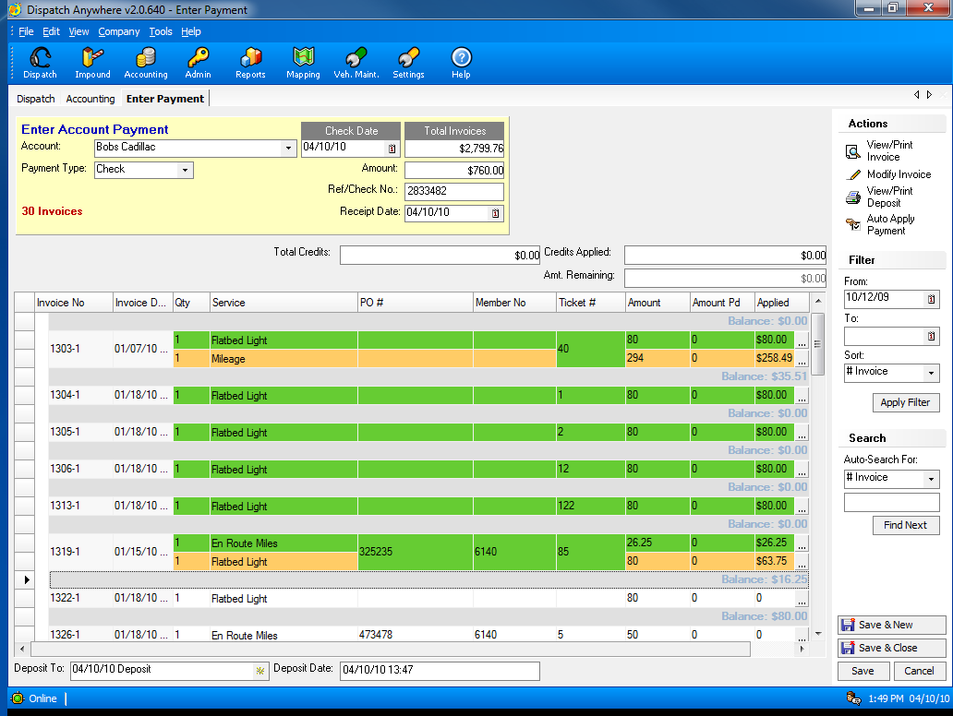
Record checks received using the Enter Payment Screen

Slide 41
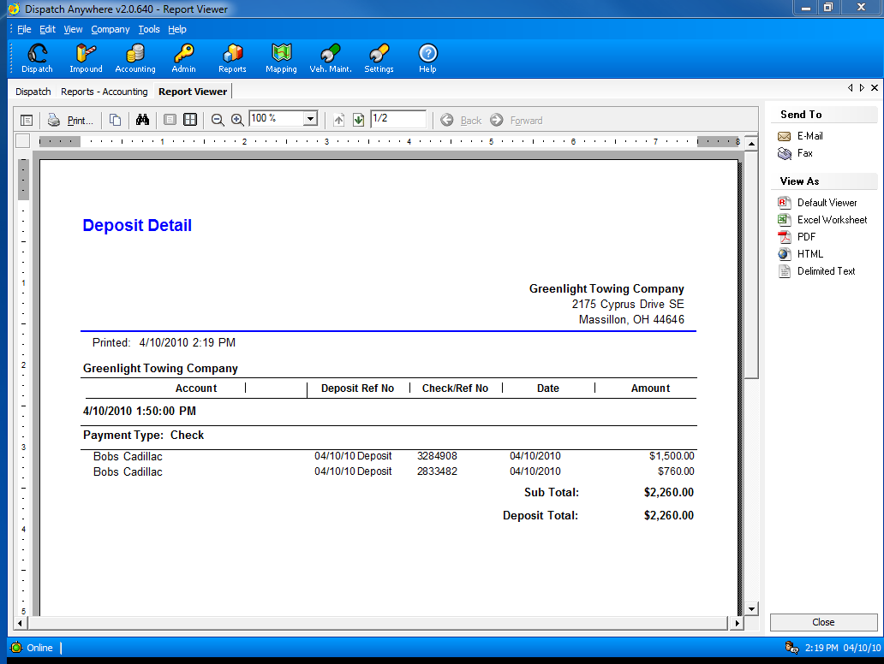
Track daily deposits

Slide 42
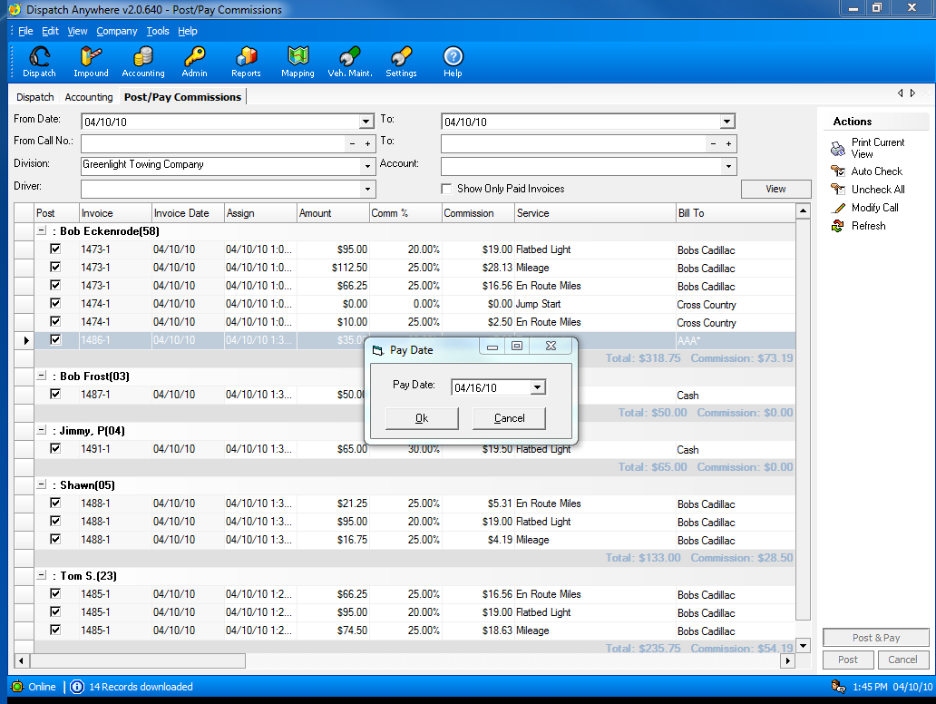
Complete automatic commission calculation and reporting.

Slide 43
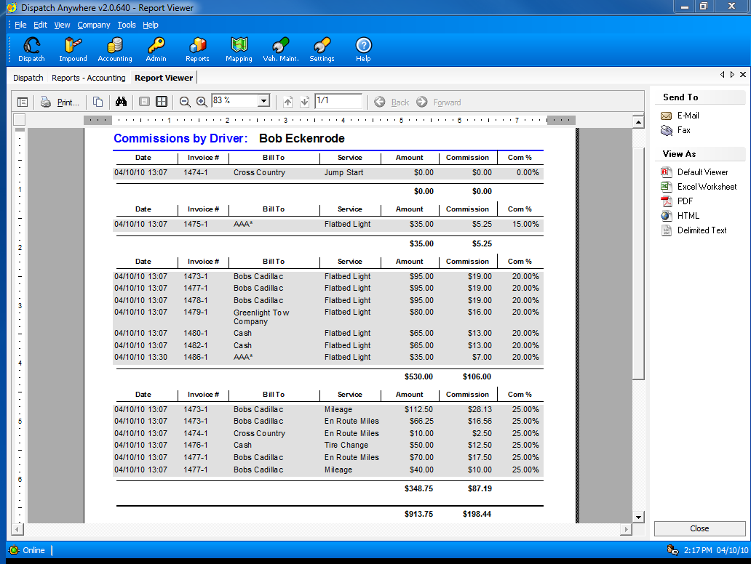
Commission Report by Percentage

Slide 44
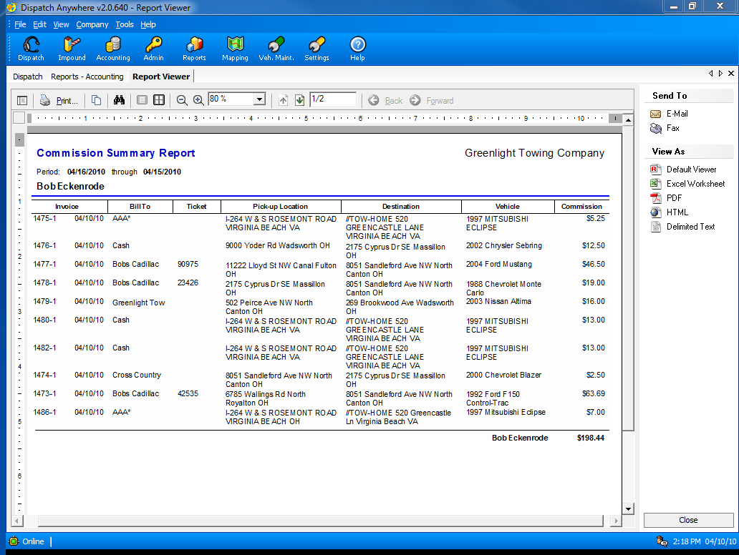
Commission Summary report

Slide 45
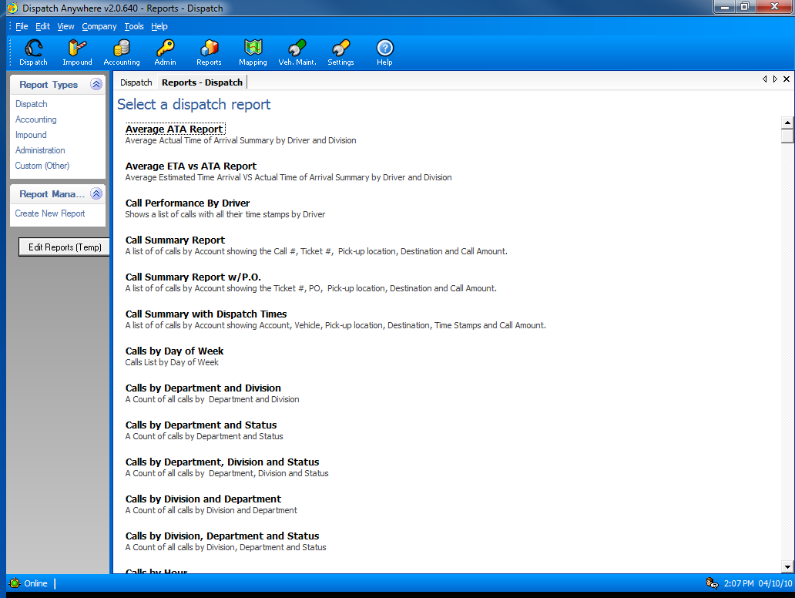
Over 100 Reports to help manage your company

Slide 46
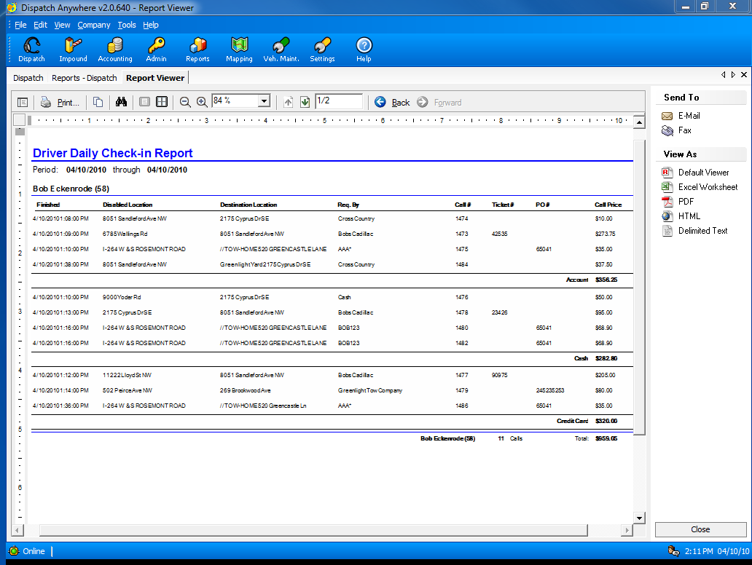
Driver Daily Check-in report to insure drivers turn in all money and paperwork.

Slide 47
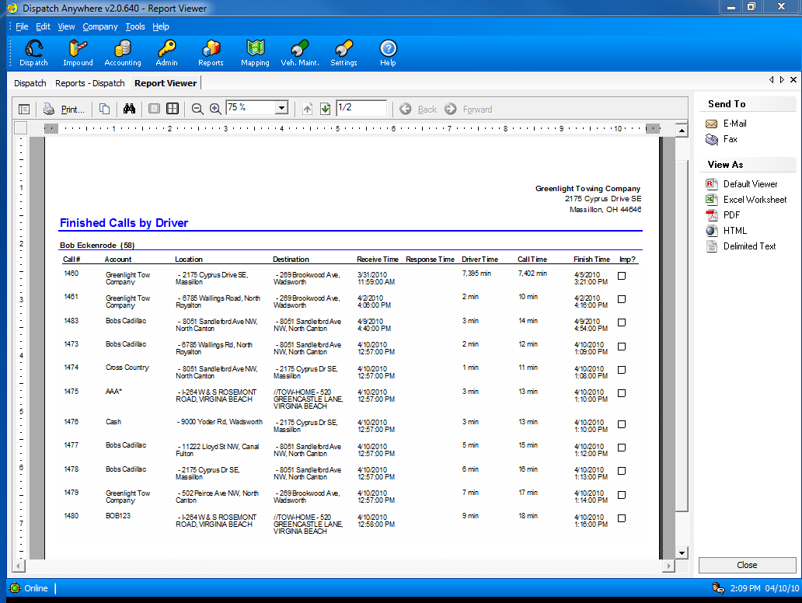
Driver Performance Reports

Slide 48
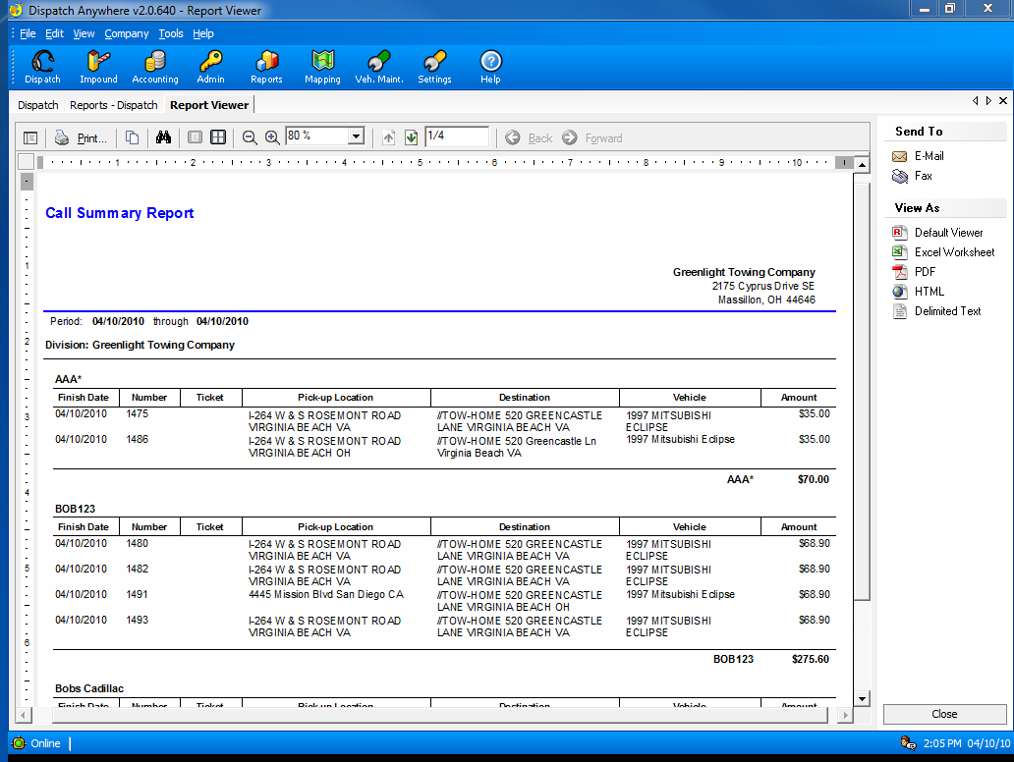
Summary of Calls for a given date range

Slide 49
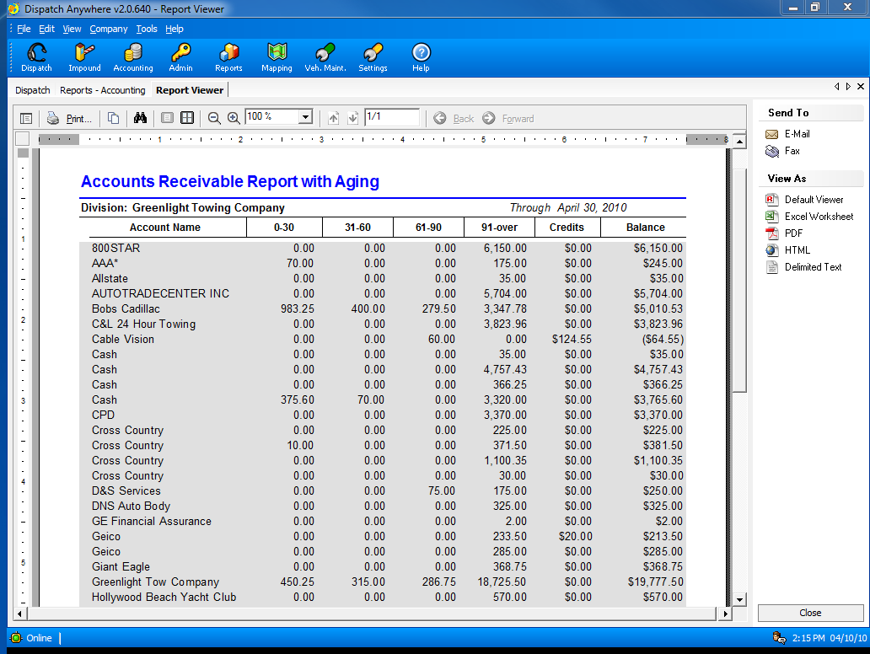
Accounts Receivable Aging Report

Slide 50
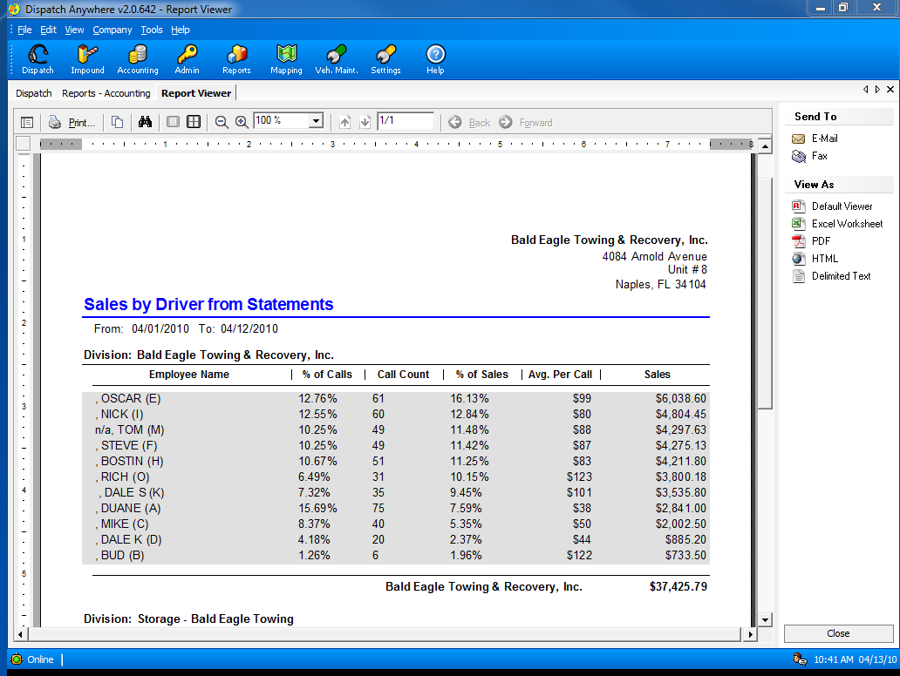
Sales by Driver Report

Slide 51
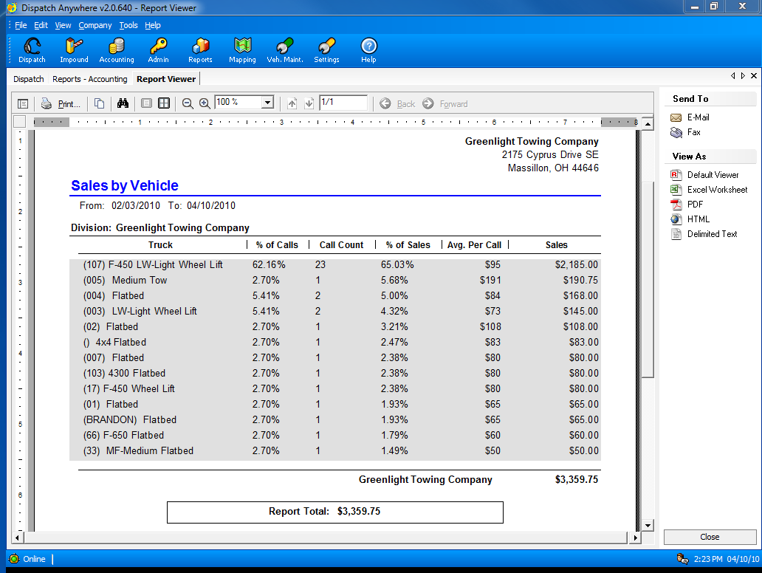
Sales by Truck

Slide 52
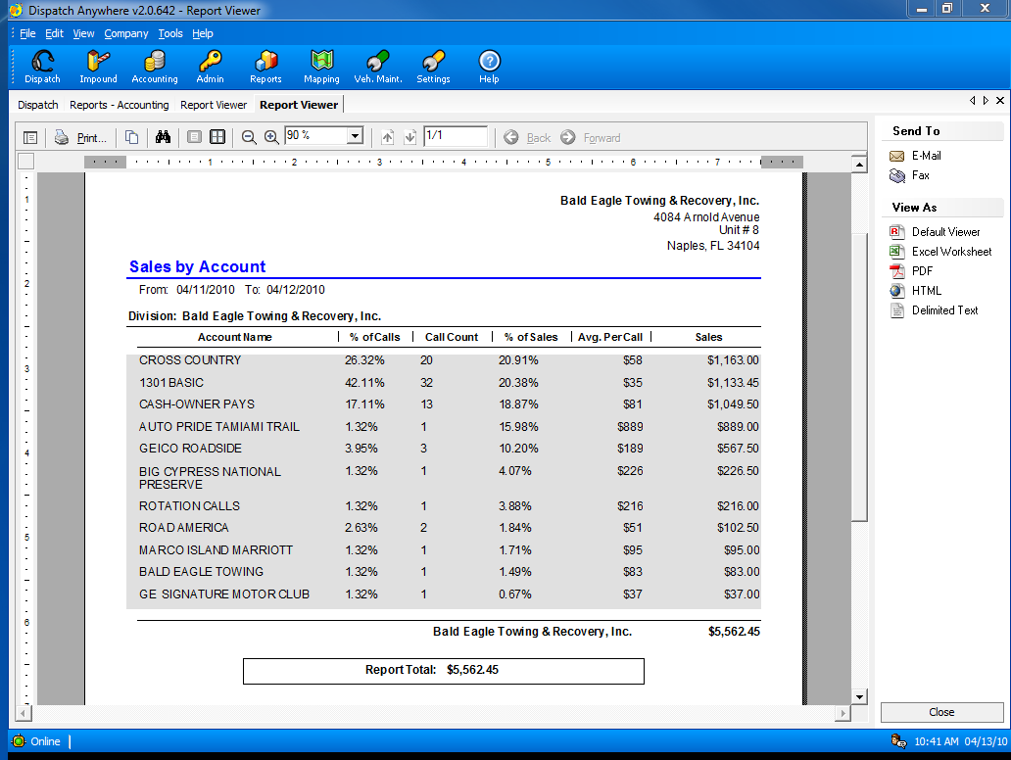
Bob’s Towing and Recovery, Inc.
Bob’s Towing and Recovery, Inc.
Sales by Account

Slide 53

Dispatch Anywhere is completely customizable so it can adapt to YOUR way of doing business – instead of you adapting to ours.

Slide 54

Advanced pricing templates to allow you to change prices for multiple accounts from a single screen.

Slide 55

Pricing can be set by day of week and/or time of day

Slide 56

You can also specify pricing by user-defined zones

Slide 57

Any service can be defined for your business

Slide 58

GPS Integration with : TomTom, VehiclePath, iTRAK, teletrac, AVLocate, DriveOk, Jett-Track, DriverLocate, StreetEagle, C3 and others

Slide 59

A Beacon Software Partner

Slide 60

A Beacon Software Partner

Slide 61

A Beacon Software Partner

Slide 62

A Beacon Software Partner

Slide 63

A Beacon Software Partner

Slide 64

A Beacon Software Partner

Slide 65

Automated Lien Processing

Slide 66

No contract required – pay as you go
(not yet available for all states)

Slide 67

Using a 3rd party lien processor will automate and simplify the entire lien process.

Slide 68

Most recent calls are at a glance when your first log into the system.

Slide 69

3 types of searches are supported: VIN, Plate and Title number.
You may also input vehicle information manually from an out of state vehicle – no cost for this.
All charges are displayed next to the field, so you always know the charge before you perform a service.

Slide 70

A complete list of all vehicles in storage is available.
You have the option to show all vehicles in storage or only vehicles that have pending/expired tasks.

Slide 71

You may view vehicle details by simply clicking on the vehicle.
You are able to quickly see what has already been done or needs to be done on this vehicle.

Slide 72

Vehicle Details

Slide 73

Notice of Lien Report that has already been sent.
You may print this report as many times as you like.
We do not charge for printing.

Slide 74

You may also print your newspaper ad.

Slide 75

A listing of all transactions is available.

Slide 76

Vehicle details may also be printed.

Slide 77

Additional forms may be printed for no extra charge.

Slide 78

Multiple owners are not a problem for the system. A lien letter will be created for each owner.

Slide 79

Electronic tracking information is available.

Slide 80

Delivery Confirmation may be printed individually or as part of the DMV packet.

Slide 81

Vehicle history may be searched at anytime.
Search by almost anything: VIN (full or partial), Color, Make, Model, date range, etc.

Slide 82

Many configuration settings are available, such as multiple company locations, multiple user logins, etc.

Slide 83

Configure your profile to set default values used by TowLien.

Slide 84

You may also search the transaction history at any time.

Slide 85
Towing and Recovery Professionals of Maryland
Your Statewide Towing Association

Slide 87
Join Today and Start Receiving Discounts

Slide 89
Stay informed of all current State regulations

Slide 90
T.R.P.M.
Provides Training Classes for your Drivers and Managers

Slide 92
Get Your National Driver Certification Through T.R.P.M.

Slide 93
Get a Gold Level Membership to TOWPARTNERS
Save 18% on your Nextel bills
Save on Tires

Slide 95

In Memory of Joan M. Hurley 8-31-1932---10-23-2010

Slide 96

In Memory of
Marvin Fremon Sylver
4-28-1943---10-29-2010

Slide 97

Joseph Donald Clagett the 3rd 12-31-1954---11-2-2010

Slide 98
Towing and
Recovery Professionals of Maryland

