Slide 1
Beacon Software Company
www.dispatchanywhere.com
Booth 1032 in the Exhibit Hall
866-437-6653

Slide 2

New for Tow Expo 2010

Slide 3

Starting at $25/month

Slide 4
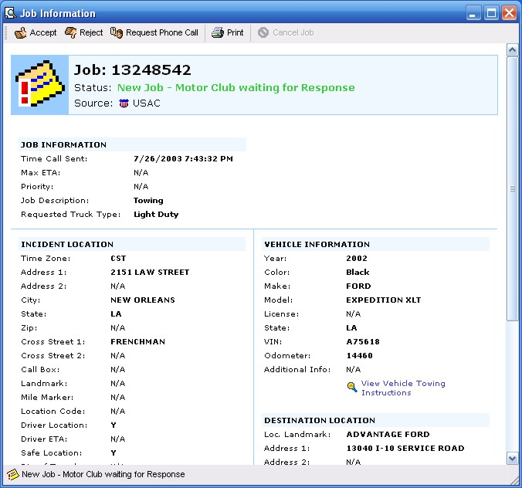
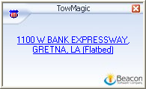
Incoming TowMagic Digital calls slide up from the bottom of the screen

Slide 5
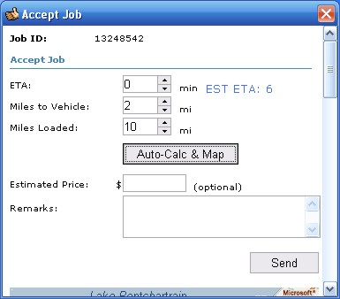
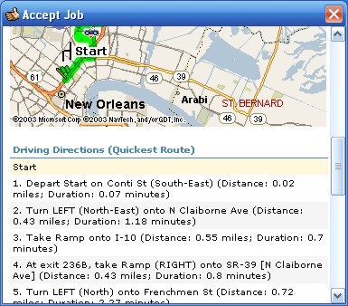
Click Accept job – input ETA and let system calculate mileages

Slide 6
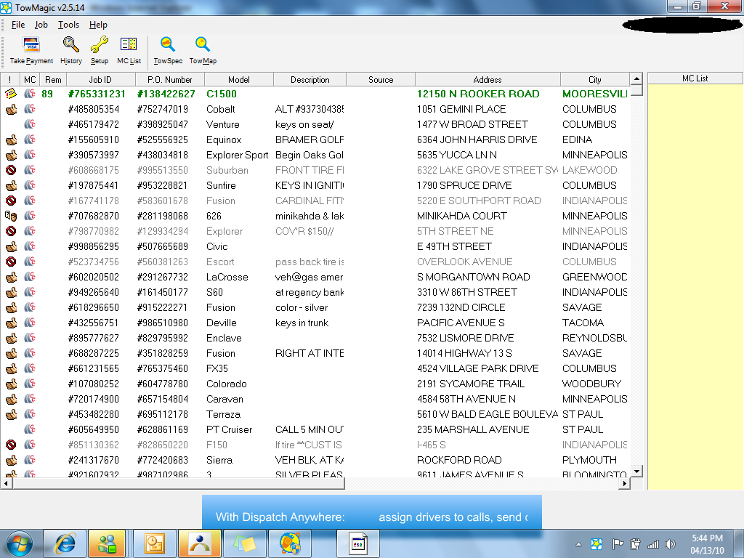
TowMagic digitally receives calls from AAA, Cross Country, Allstate, Signature, Geico, NSD, USAC and others

Slide 7
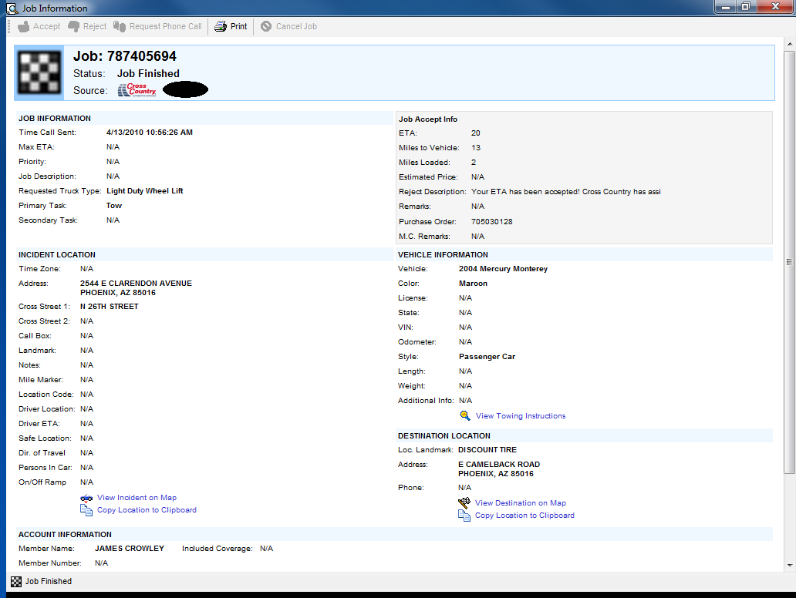
Job Information for a TowMagic call is displayed – then it is transferred automatically to Dispatch Anywhere to be sent to a driver via a text message

Slide 8
Dispatch Anywhere starts at $199 setup and $50/mo

Slide 9
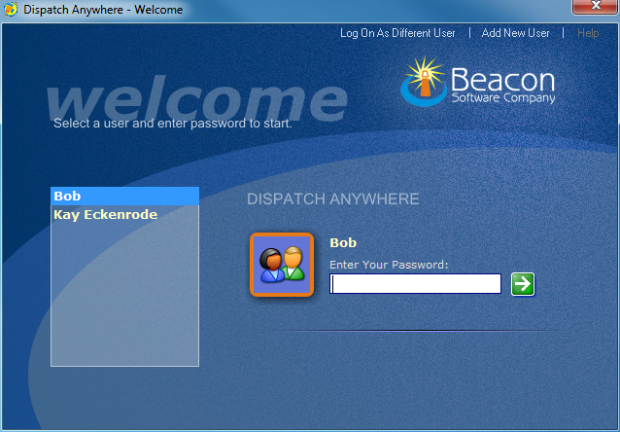
Dispatch Anywhere - Login Screen

Slide 10
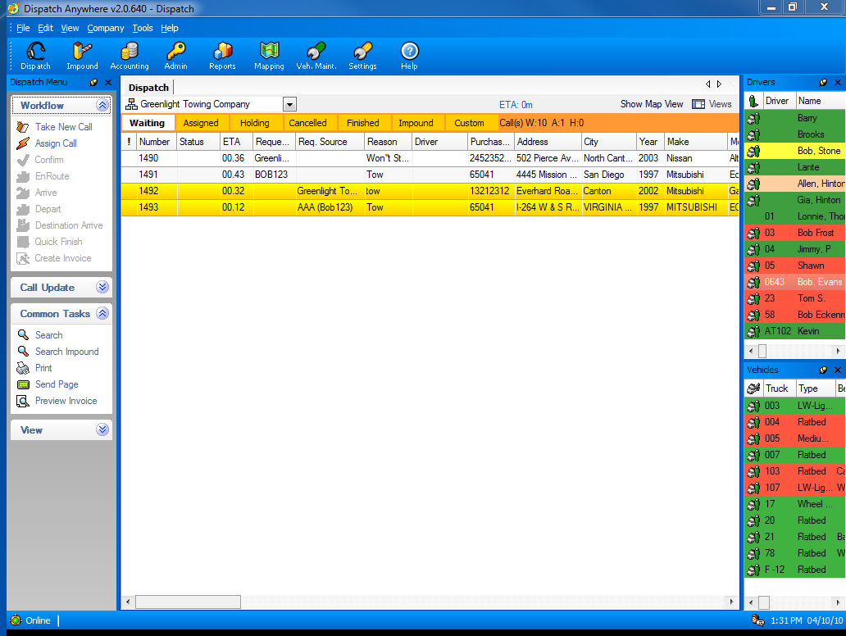
Dispatch Screen: Calls are digitally received from AAA, Asurion, Cross Country, Allstate, Signature, Geico, NSD, NAC, Coach-Net, Quest, Road America, USAC and your Customers

Slide 11
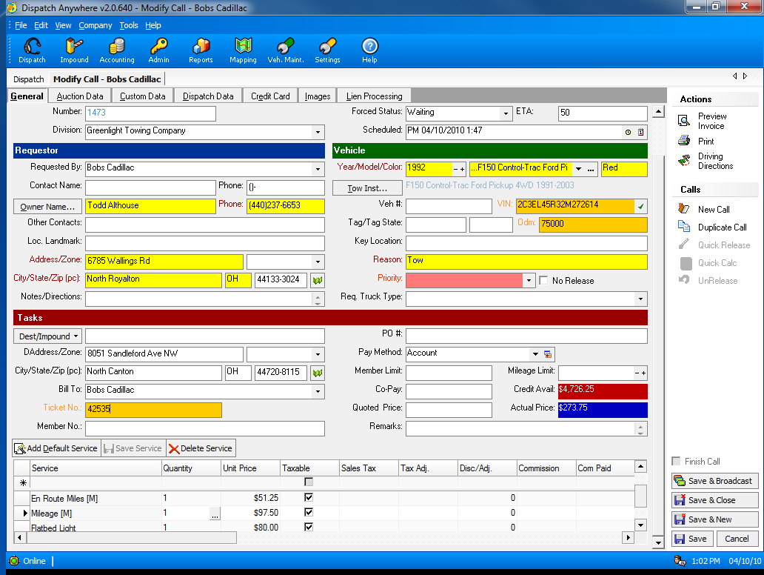
Call taking screen: Automatic Pricing, CC Processing, VIN Validation and TowSpec Towing Instructions

Slide 12
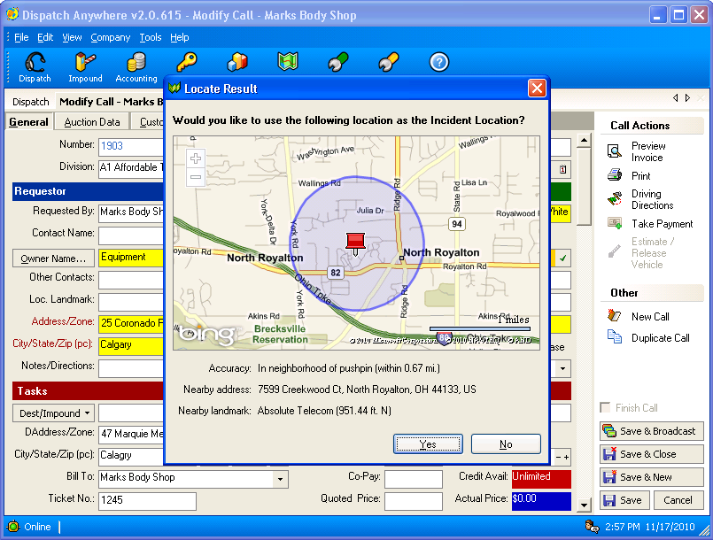
GPS Motorist Locator
Instantly retrieve a caller’s GPS location from the phone number

Slide 13
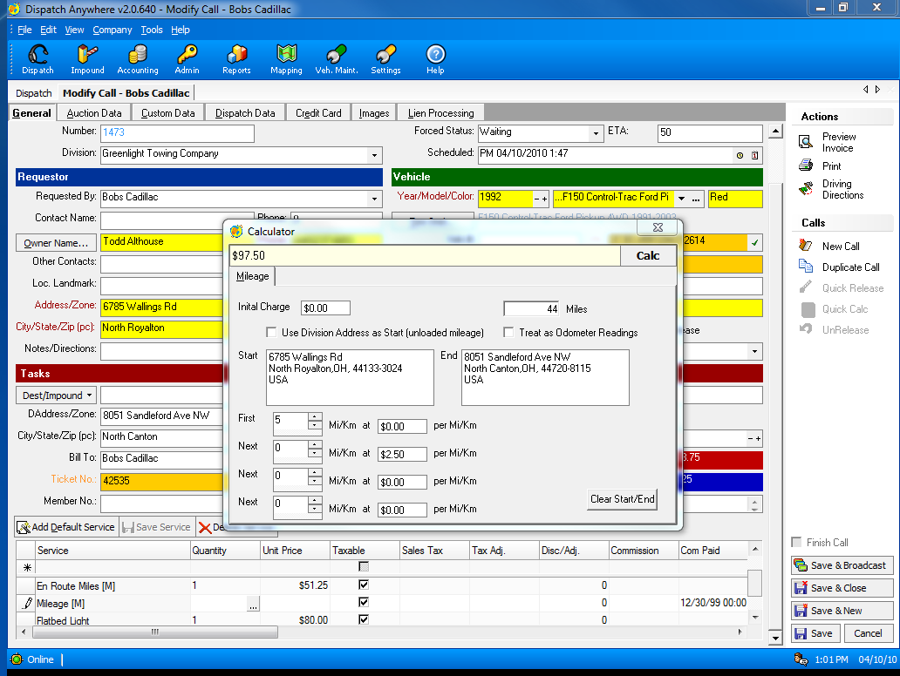
Built in Mileage Calculator

Slide 14
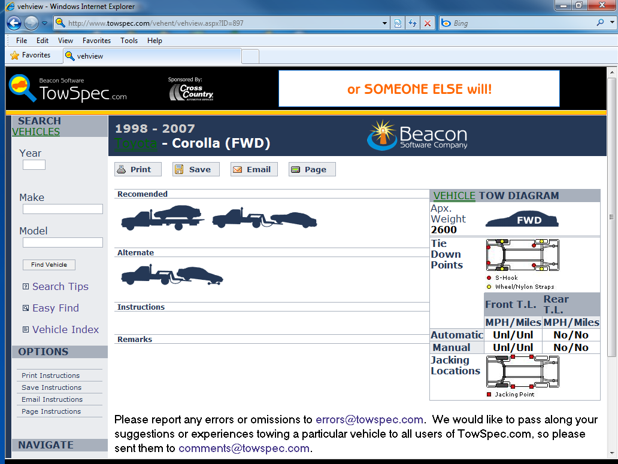
Integrated TowSpec Towing Instructions are just a click away

Slide 15
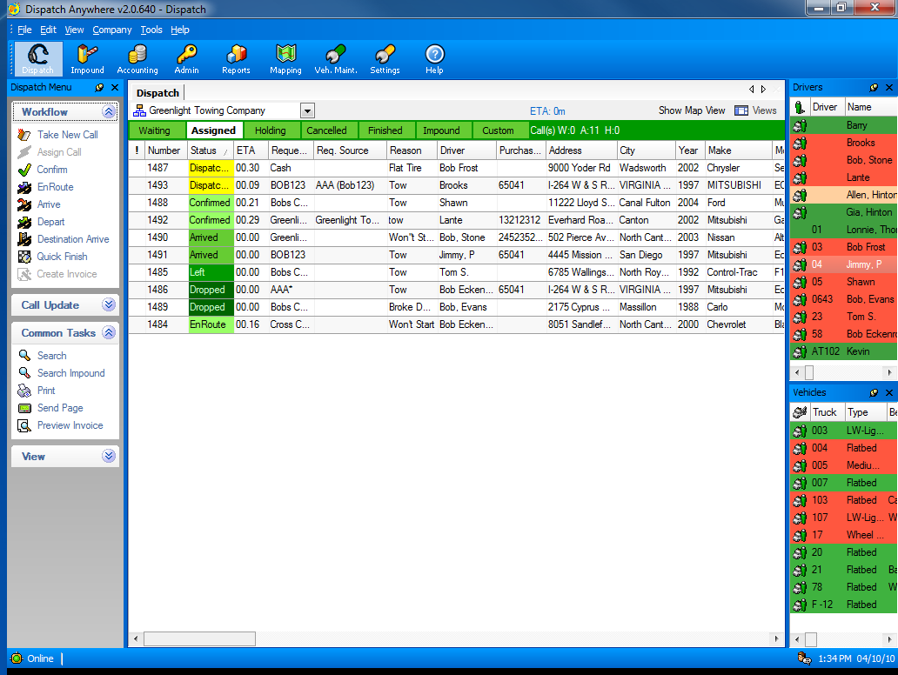
Main Dispatching Screen – status is automatically updated by driver via Pager, Cell Phone or in-vehicle MDT message

Slide 16
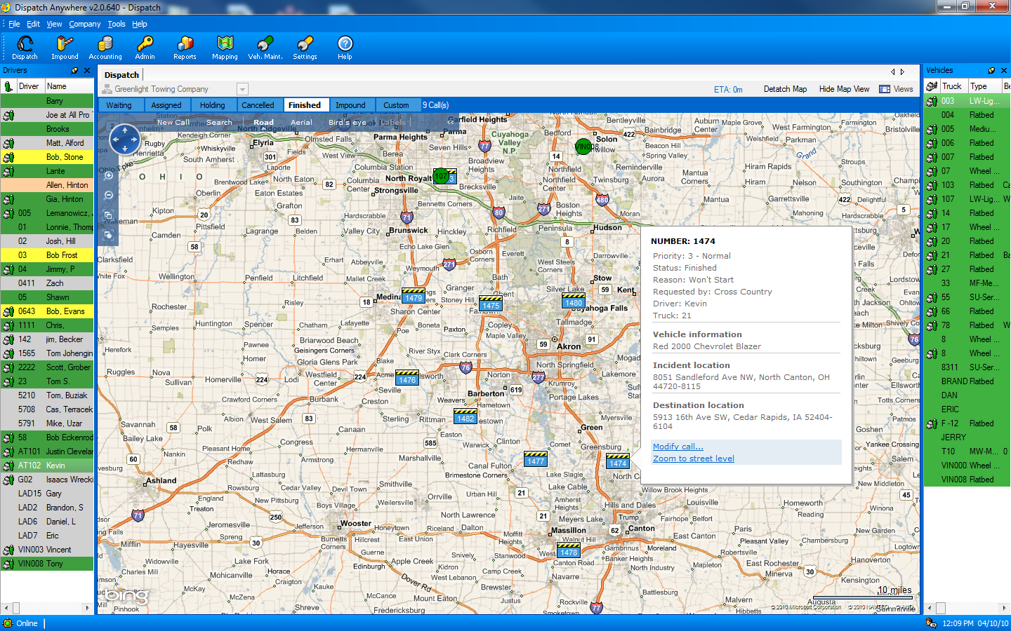
Dispatch Screen shown with Visual Dispatch and GPS integration

Slide 17
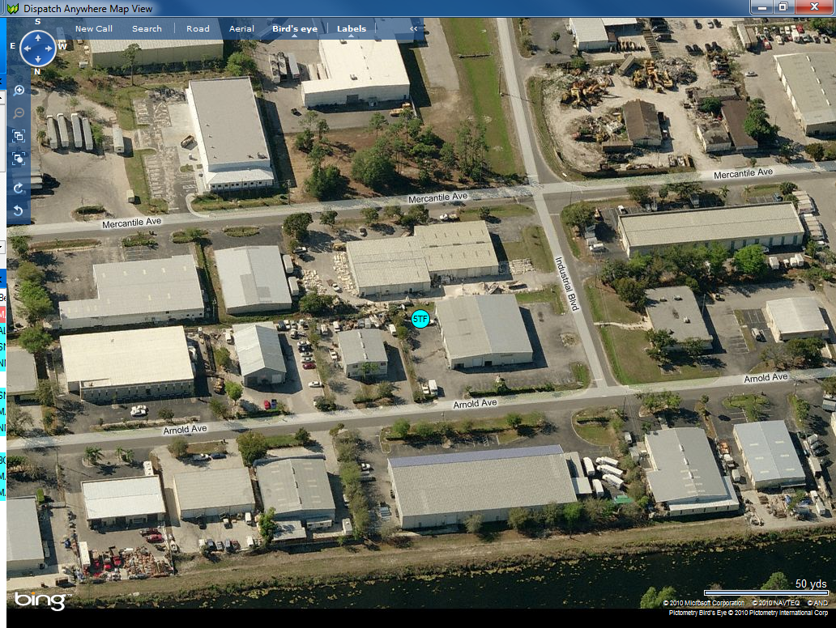
Mapping includes Bird’s Eye View - see the truck parked at shop.

Slide 18
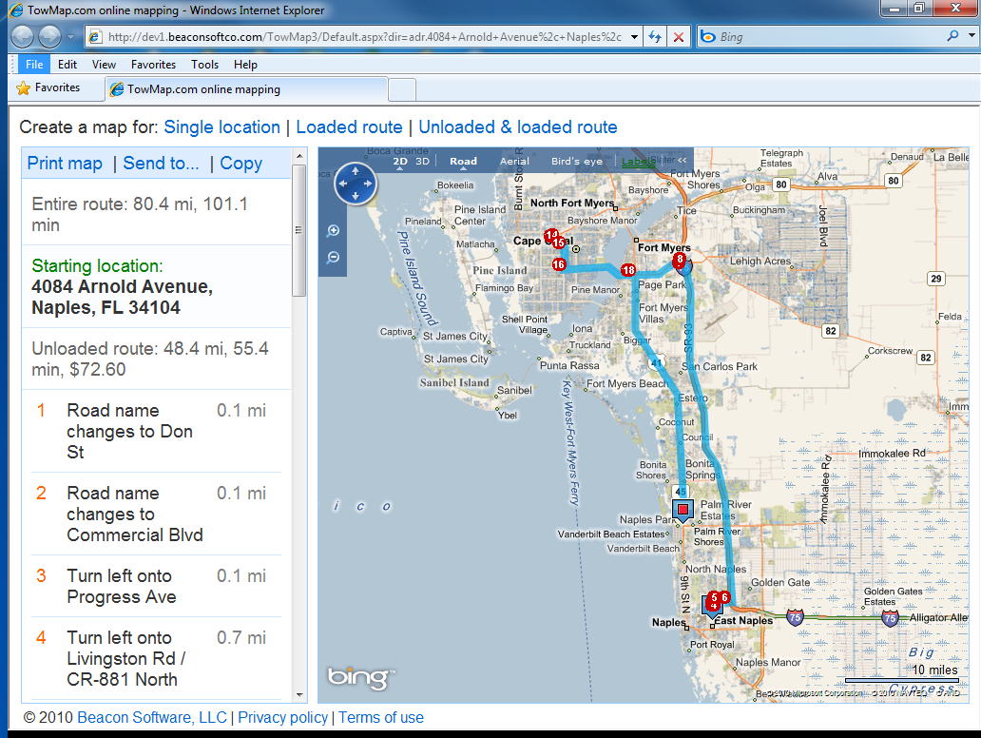
Integrated Driving Directions with Mileage calculations

Slide 19
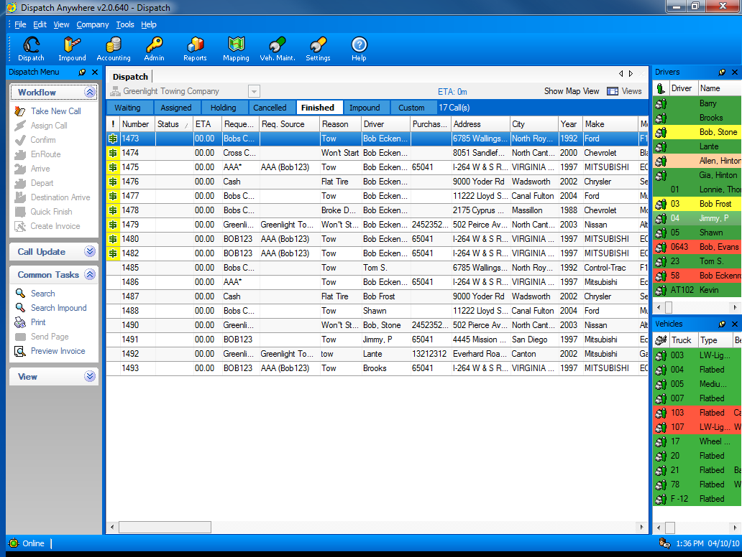
Calls are sent to Finished after clear time is received from a driver’s mobile device – pager, cell phone, or in-vehicle MDT

Slide 20
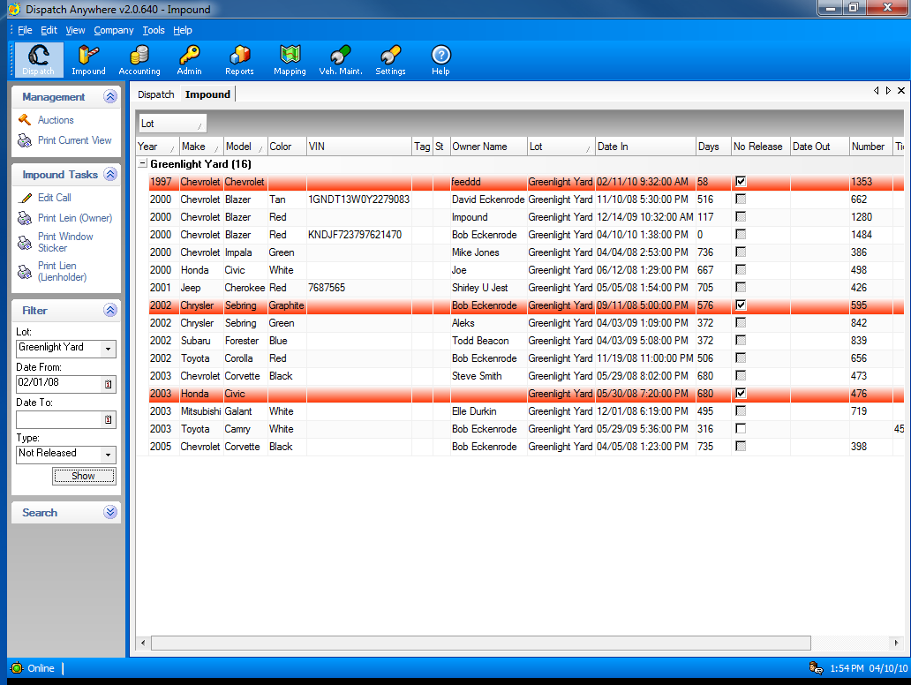
Complete Impound Lot Management

Slide 21
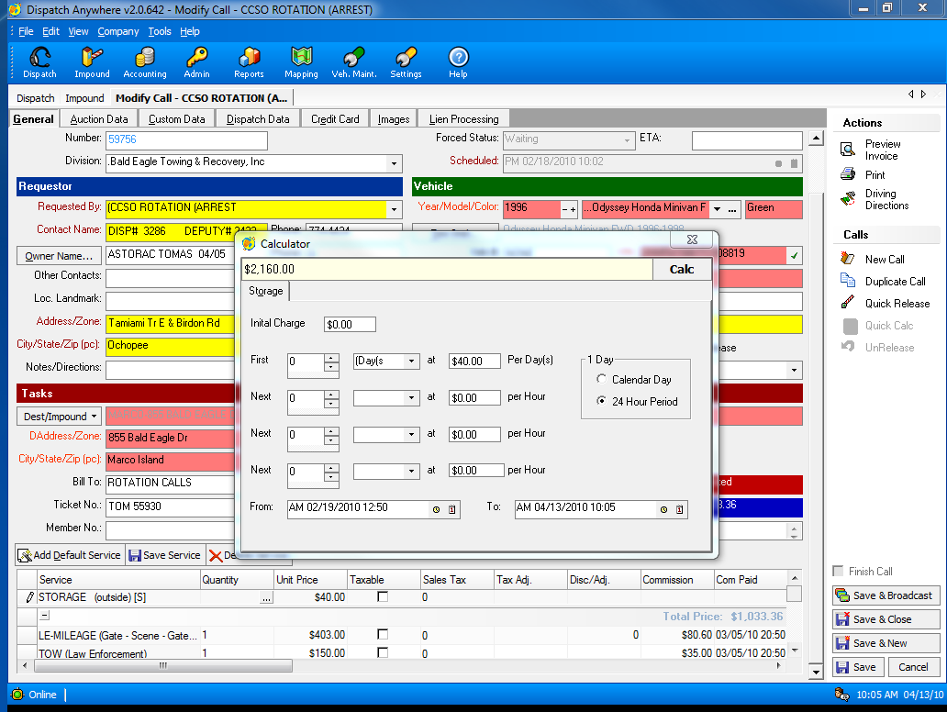
Integrated Storage Calculator configurable by account

Slide 22
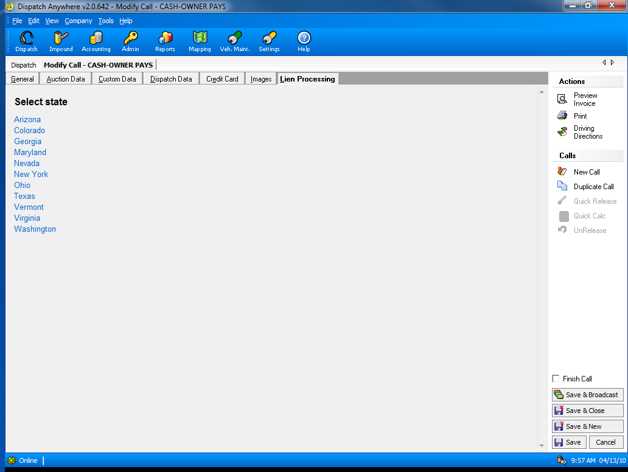
Built-in Lien Letters for many states
(FL, TX, MD, VA should use Towlien.com)

Slide 23
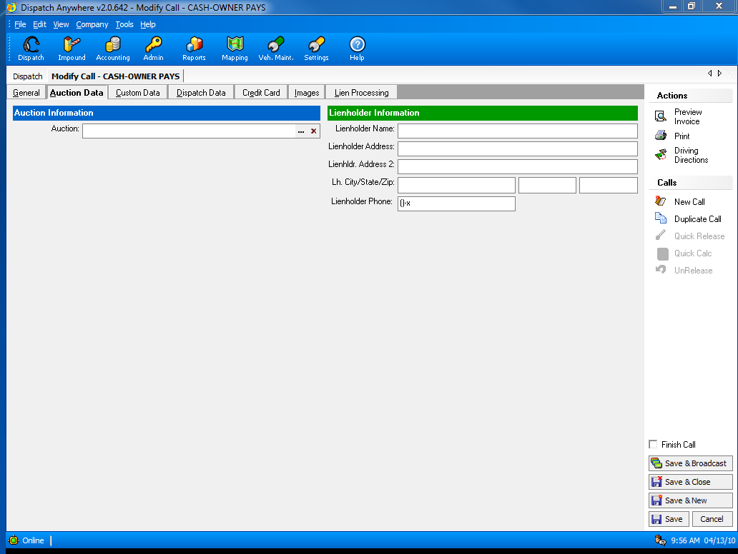
You can track cars for Auction

Slide 24
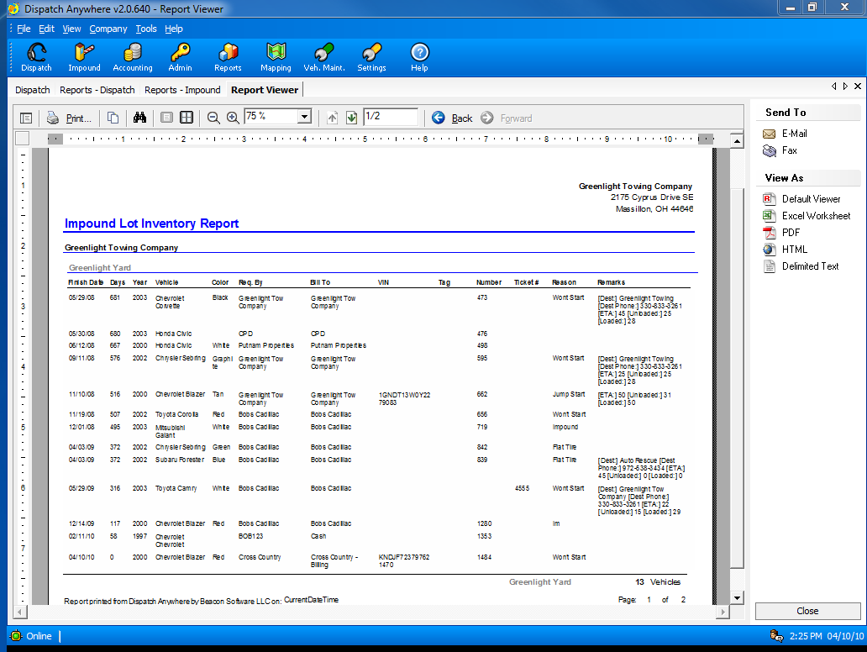
Impound Inventory Report

Slide 25
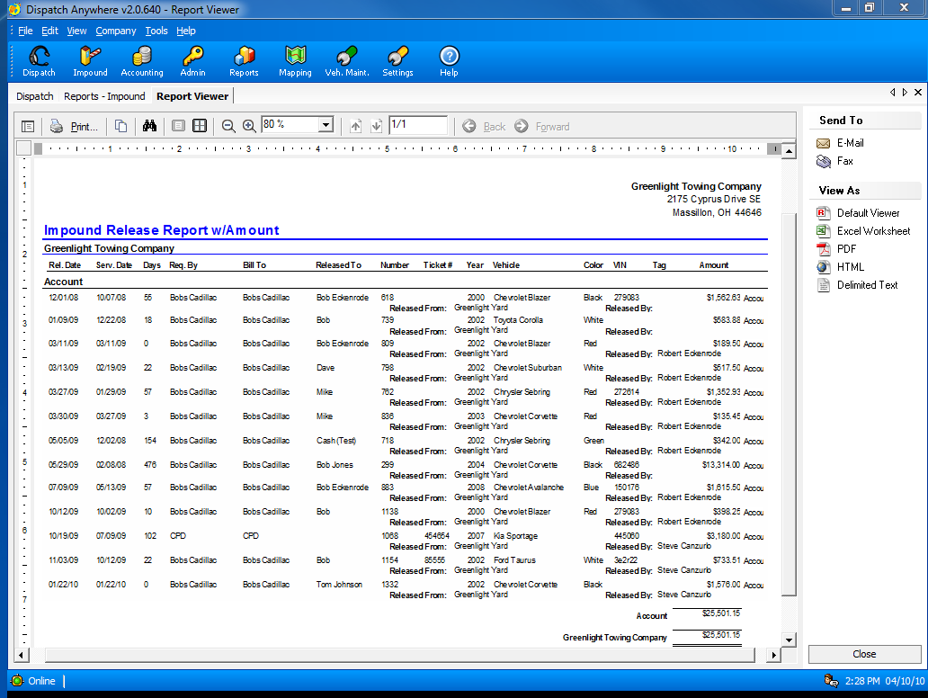
Impound Release Report

Slide 26
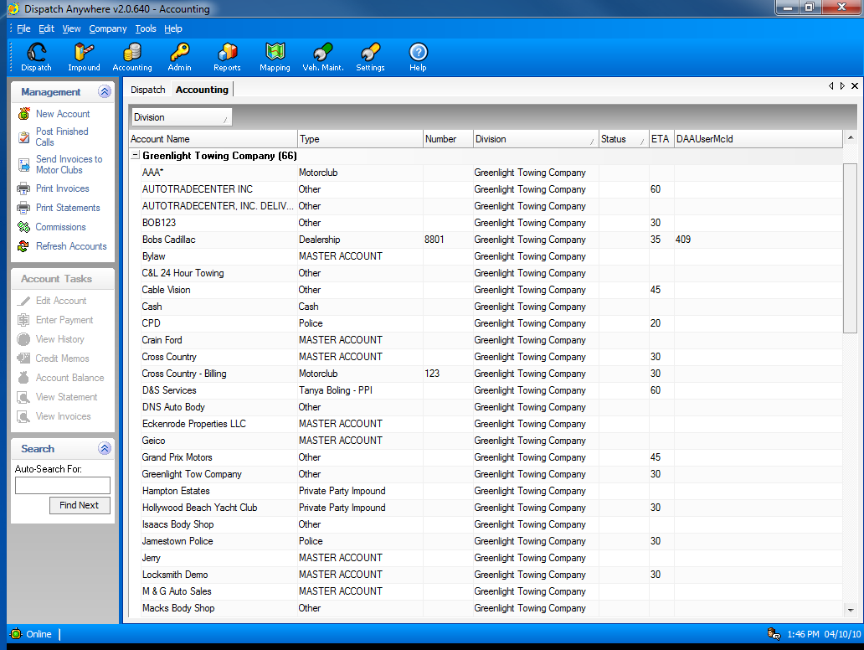
Complete built-in Accounts Receivable or Export invoices to QuickBooks

Slide 27
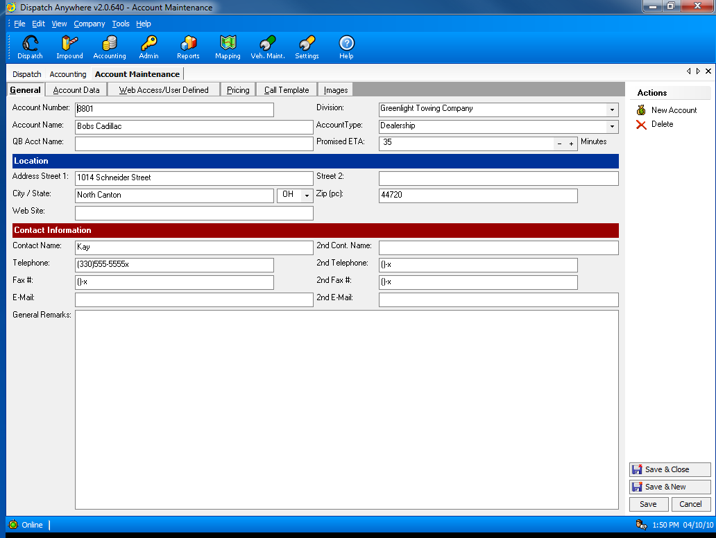
Account Configuration Screen

Slide 28
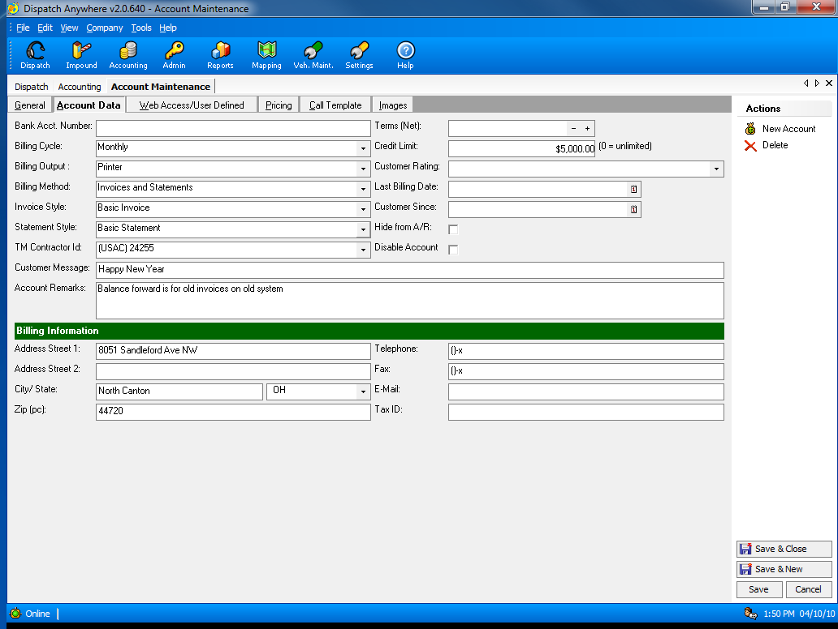
Ability to set Credit Limits by account

Slide 29
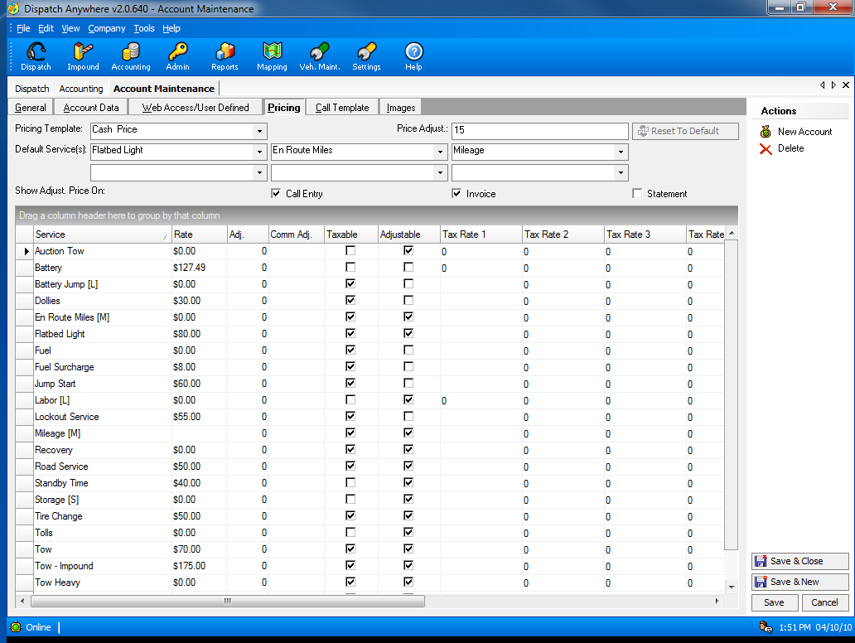
Complete pricing setup by account, so all calls will be automatically priced correctly.

Slide 30
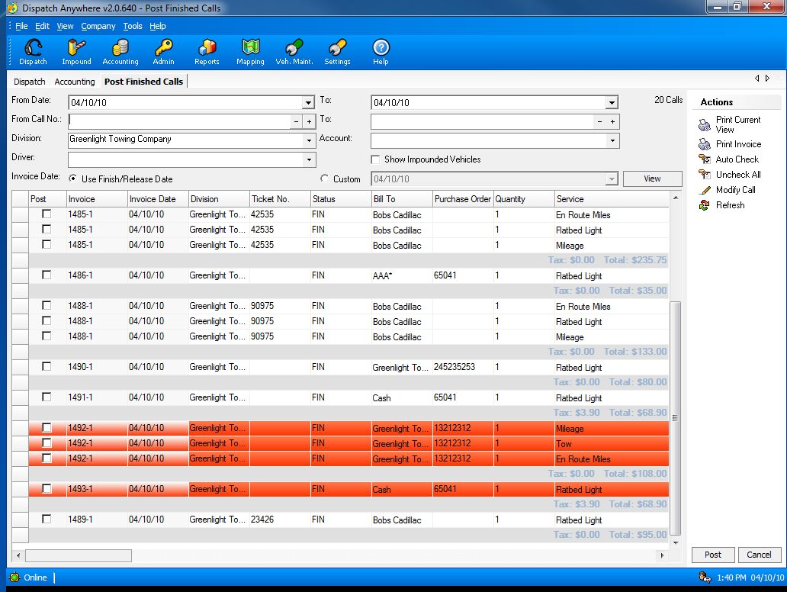
Verification of call charges is part of the complete integrated Accounts Receivable

Slide 31
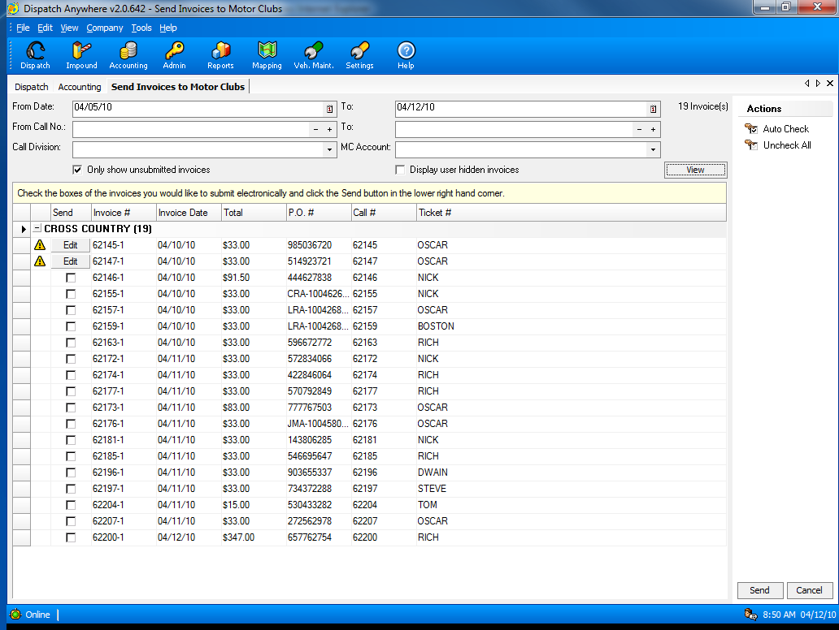
Automated Motor club Billing for Cross Country, USAC, Geico, Signature, Asurion, Allstate, Quest, Coach-Net, Road America – NO NEED for Argosi.

Slide 32
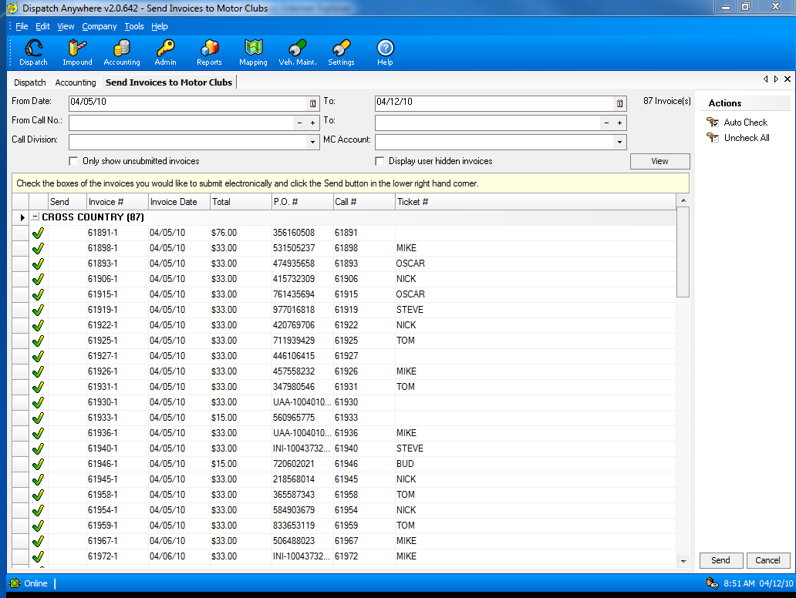
Calls successfully submitted to Cross Country – Argosi.
This process took less than 2 minutes for all calls shown.

Slide 33
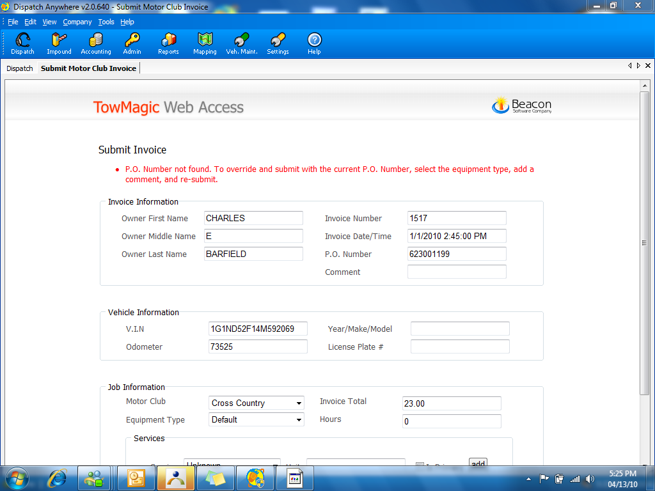
If there is missing or incorrect information for a call, the Motor Club Billing system will prompt the user to correct the call

Slide 34
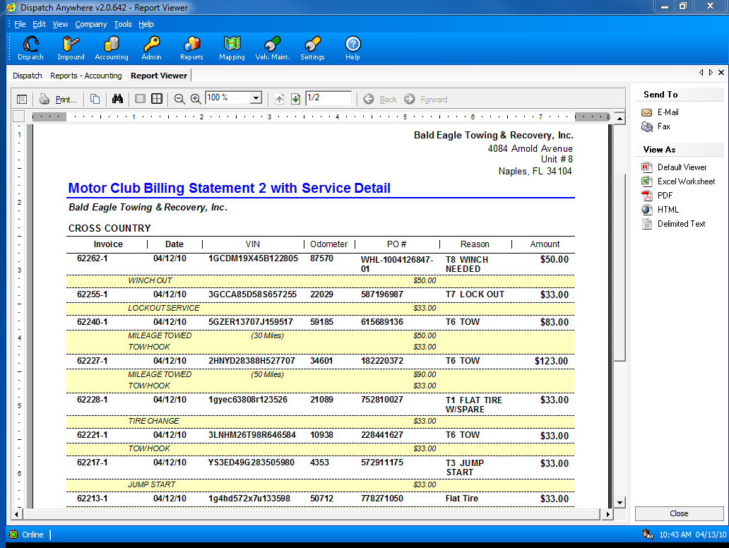
Bob’s Towing and Recovery, Inc.
Bob’s Towing and Recovery, Inc.
You may use this report for Allstate and others that do not have an online billing site so Dispatch Anywhere can do it automatically.

Slide 35
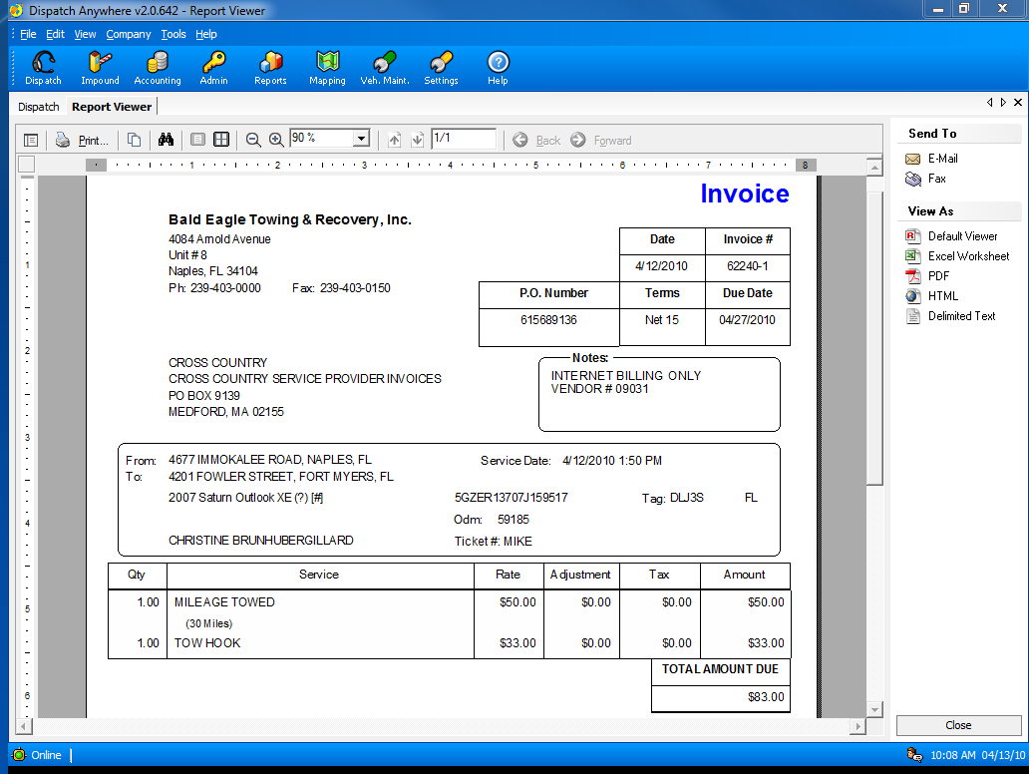
Bob’s Towing and Recovery, Inc.
Many built-in selectable Invoice Styles by account

Slide 36
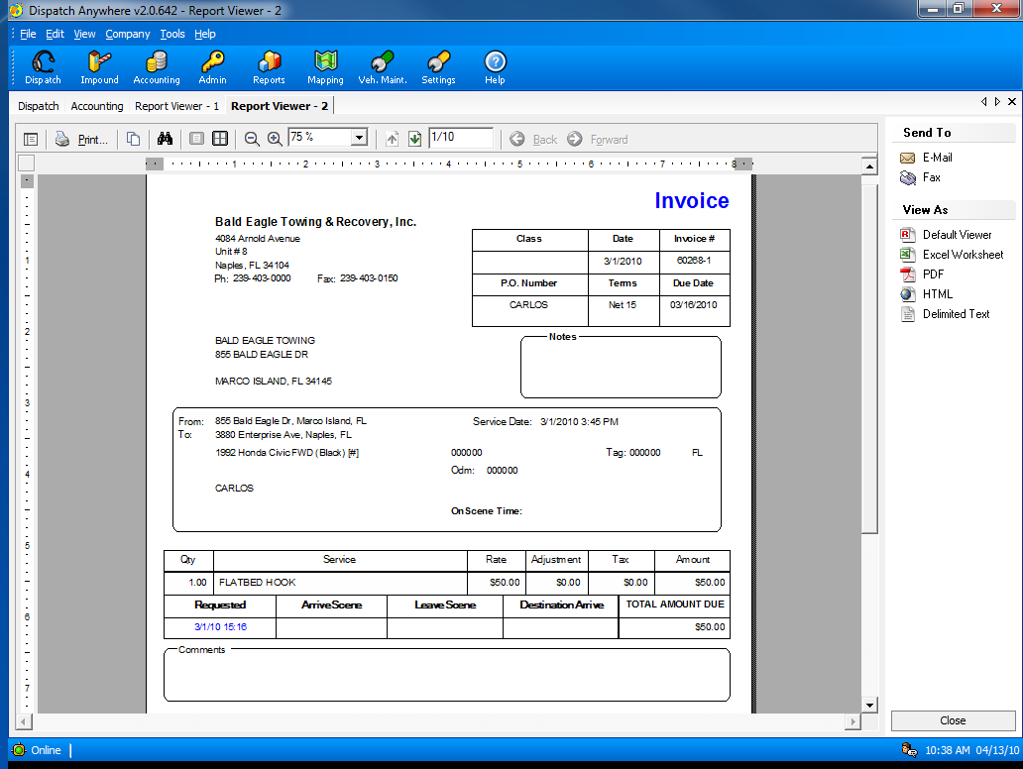
Bob’s Towing and Recovery, Inc.
Many built-in selectable Invoice Styles by account

Slide 37
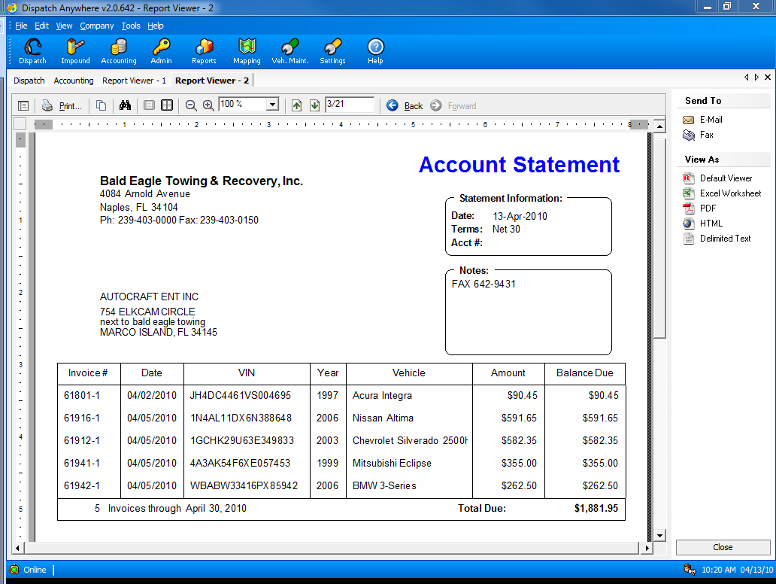
Bob’s Towing and Recovery, Inc.
Bob’s Supply Co.
Many selectable built-in statement styles by account

Slide 38
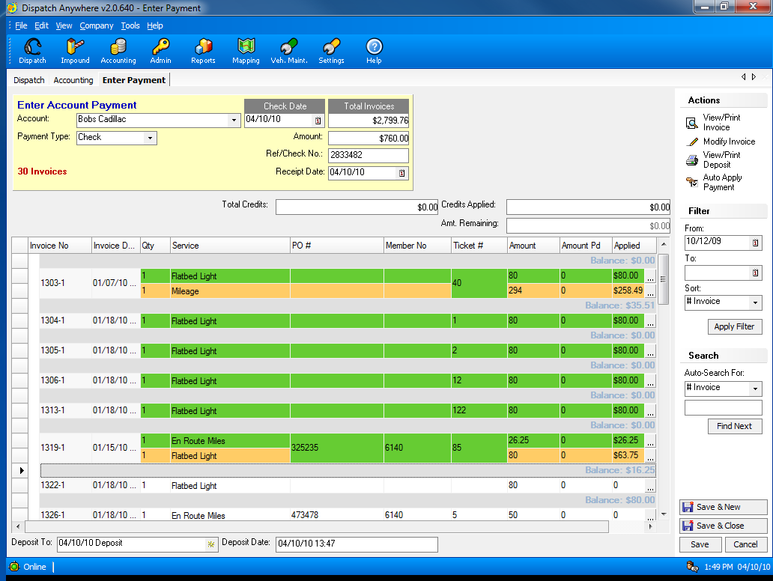
Record checks received using the Enter Payment Screen

Slide 39
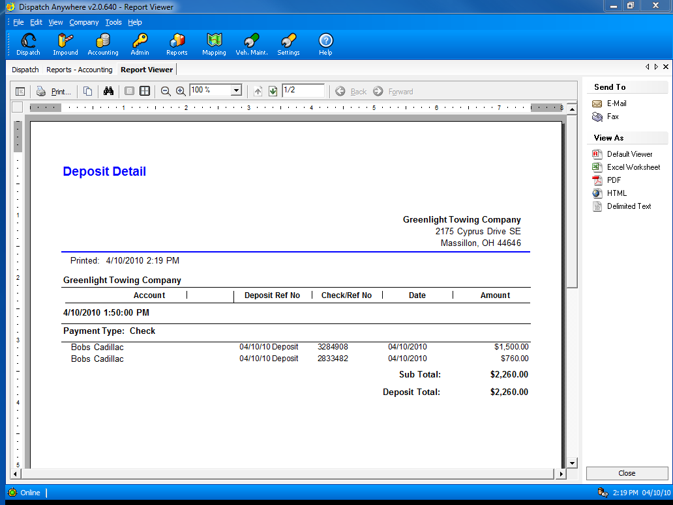
Track daily deposits

Slide 40
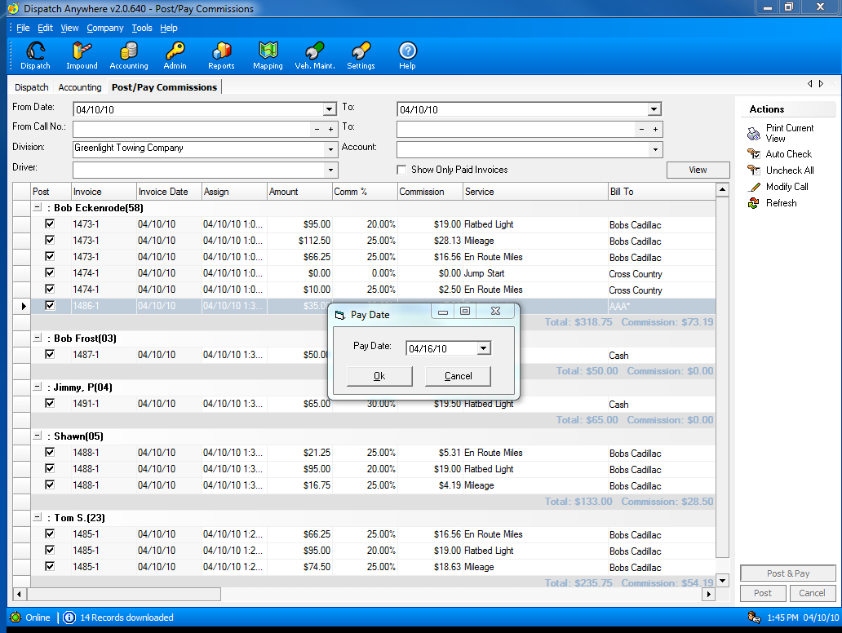
Complete automatic commission calculation and reporting.

Slide 41
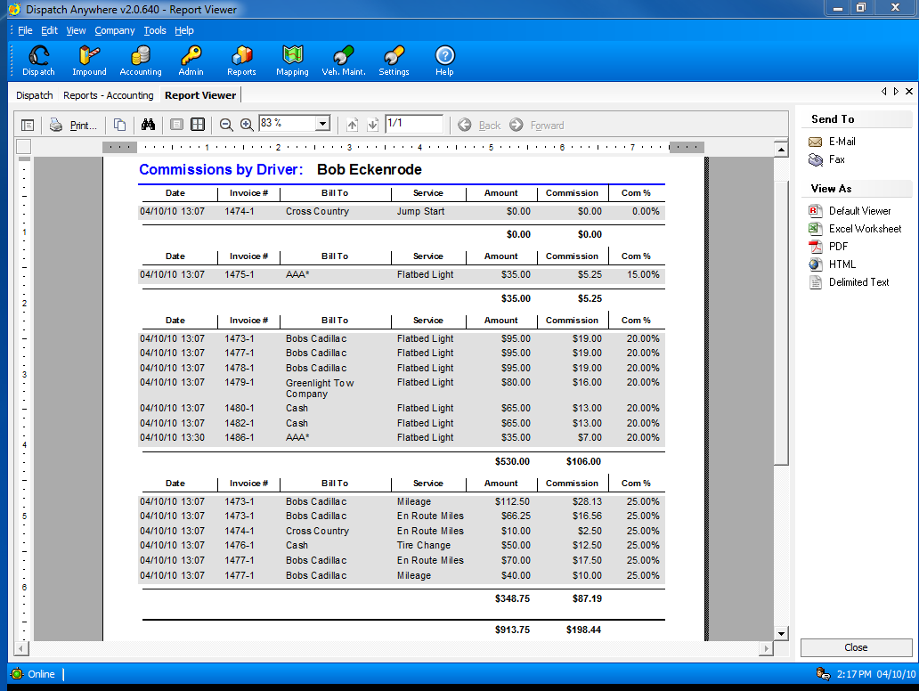
Commission Report by Percentage

Slide 42
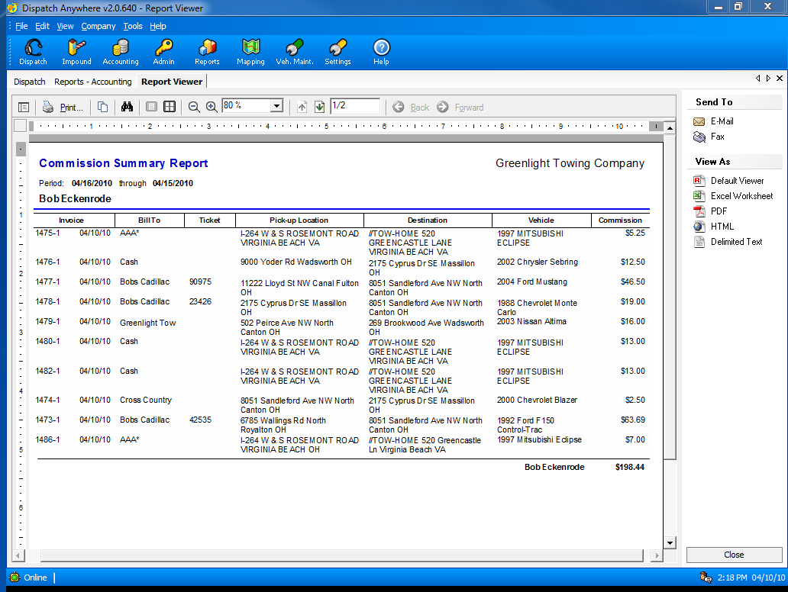
Commission Summary report

Slide 43
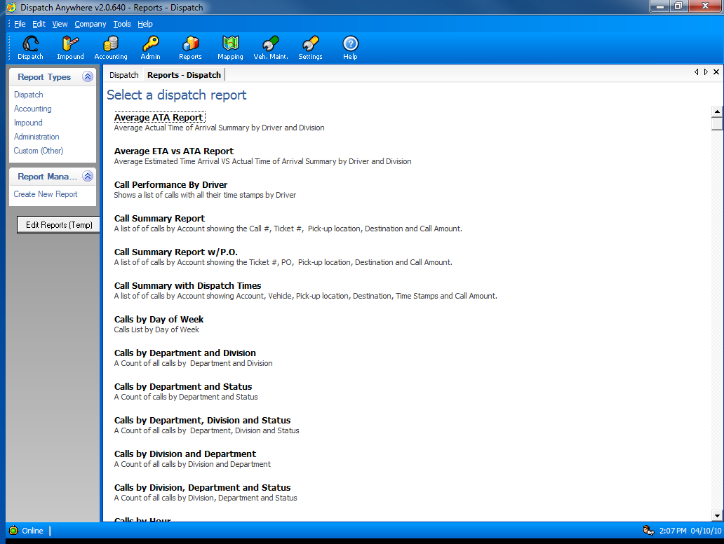
Over 100 Reports to help manage your company

Slide 44
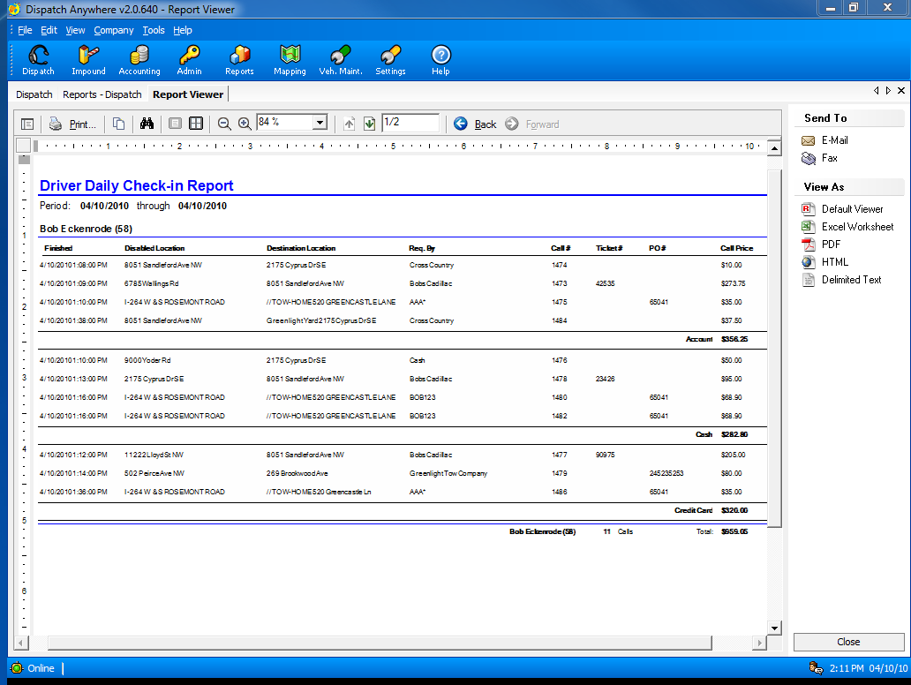
Driver Daily Check-in report to insure drivers turn in all money and paperwork.

Slide 45
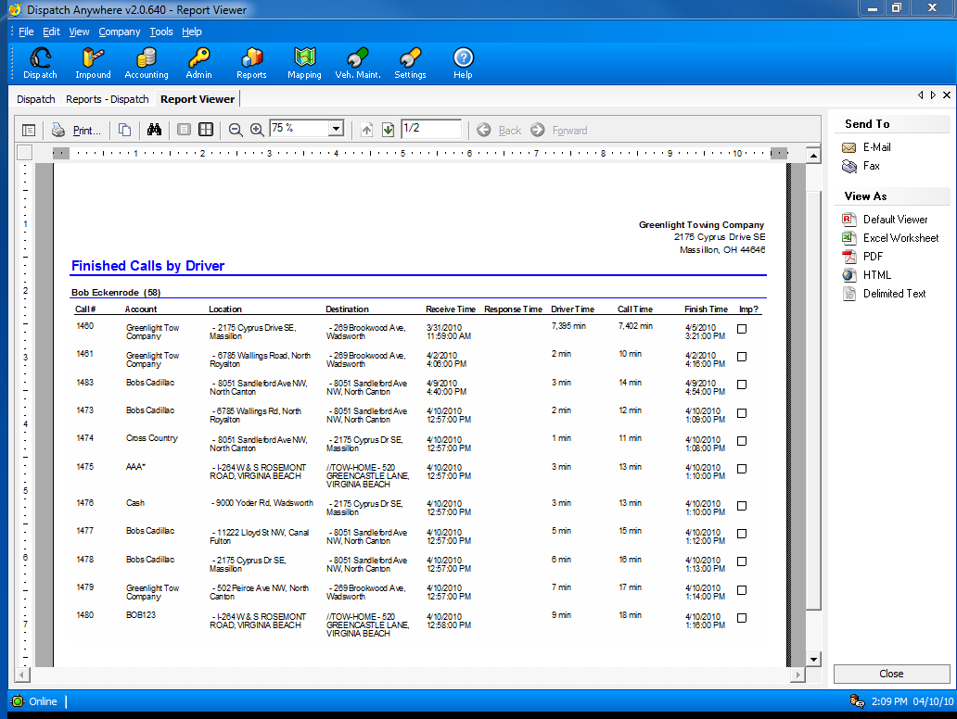
Driver Performance Reports

Slide 46
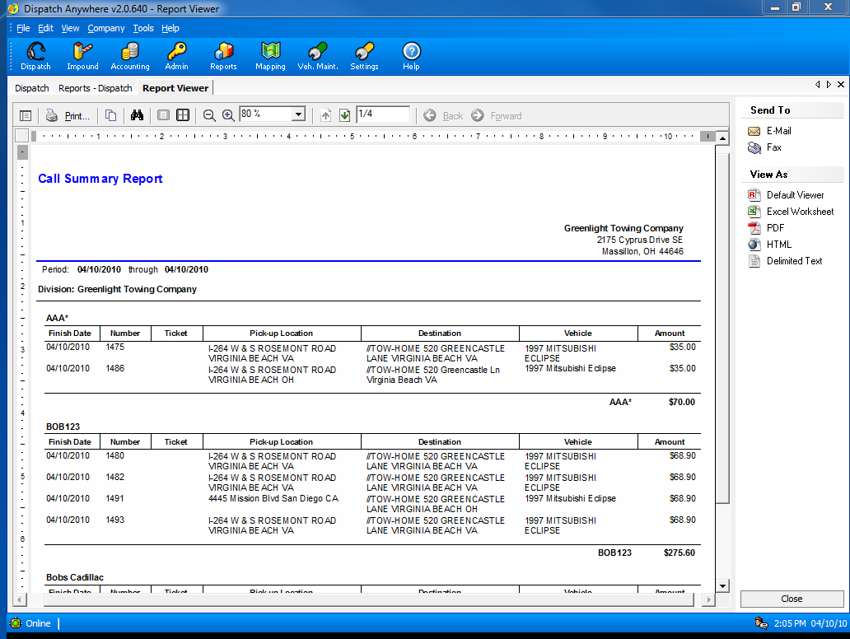
Summary of Calls for a given date range

Slide 47
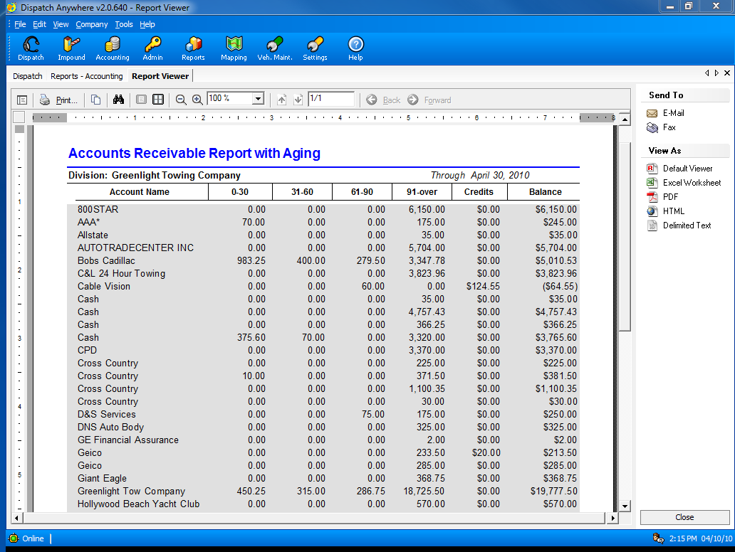
Accounts Receivable Aging Report

Slide 48
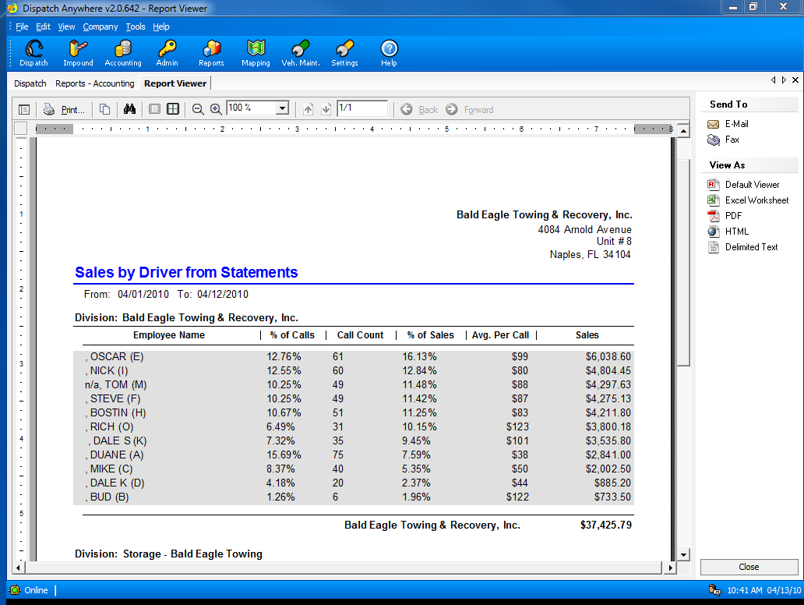
Sales by Driver Report

Slide 49
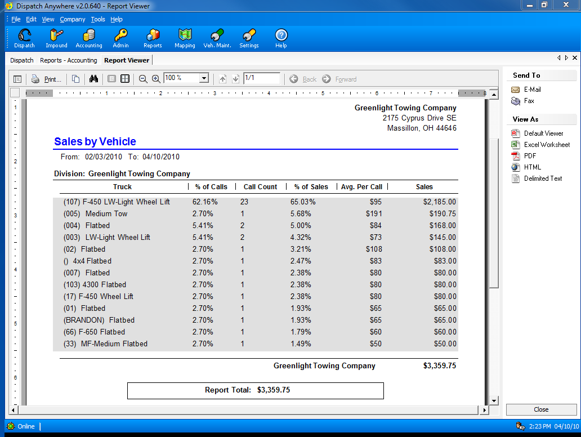
Sales by Truck

Slide 50
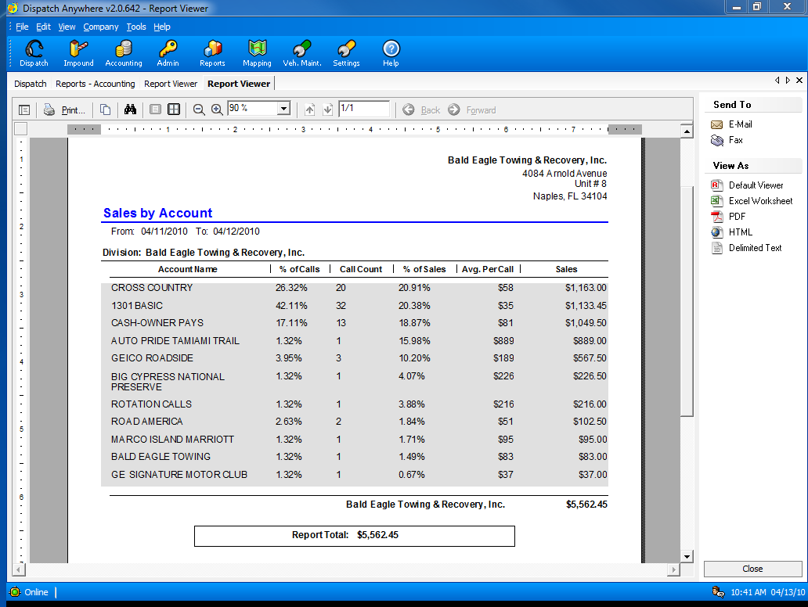
Bob’s Towing and Recovery, Inc.
Bob’s Towing and Recovery, Inc.
Sales by Account

Slide 51
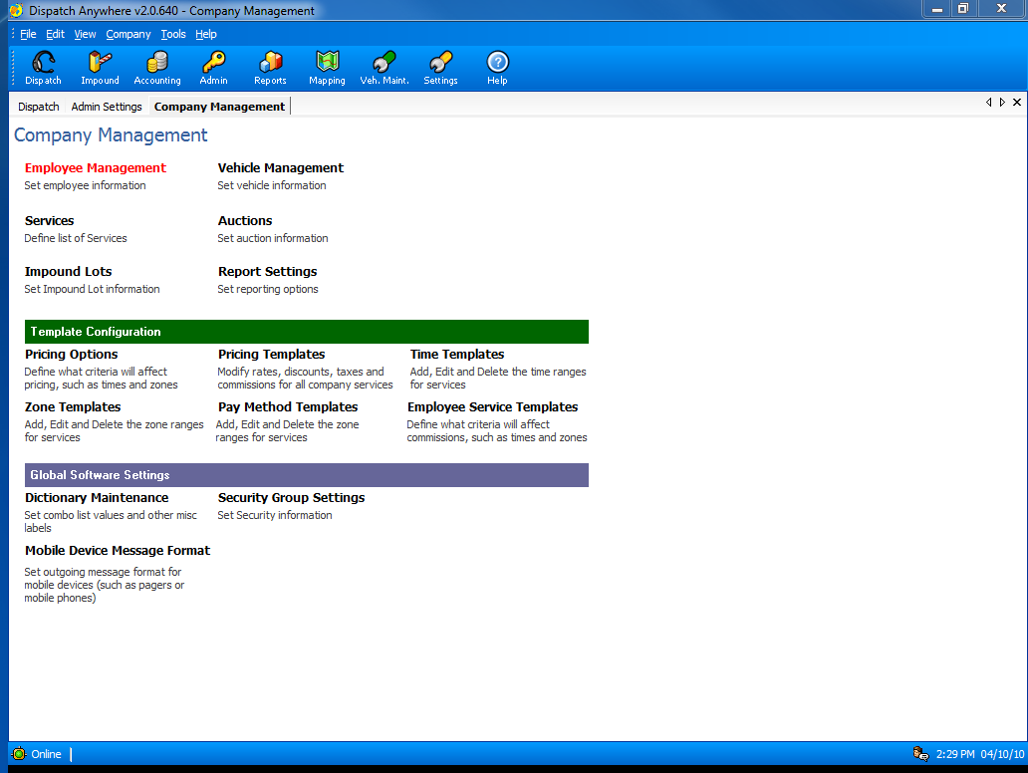
Dispatch Anywhere is completely customizable so it can adapt to YOUR way of doing business – instead of you adapting to ours.

Slide 52
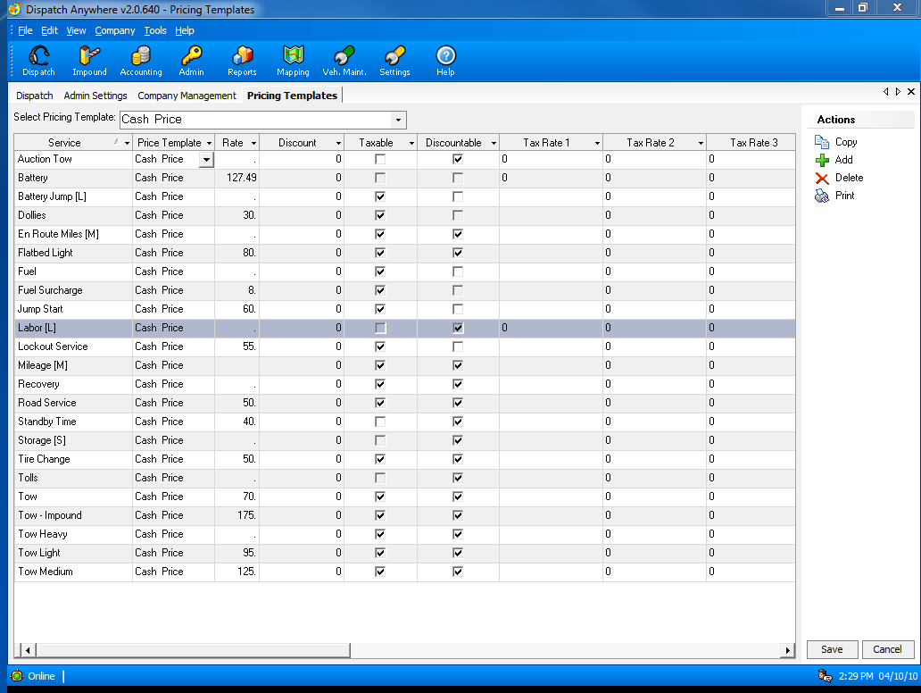
Advanced pricing templates to allow you to change prices for multiple accounts from a single screen.

Slide 53

Pricing can be set by day of week and/or time of day

Slide 54

You can also specify pricing by user-defined zones

Slide 55

Any service can be defined for your business

Slide 56

GPS Integration with : TomTom, VehiclePath, iTRAK, teletrac, AVLocate, DriveOk, Jett-Track, DriverLocate, StreetEagle, C3 and others

Slide 57

A Beacon Software Partner

Slide 58

A Beacon Software Partner

Slide 59

A Beacon Software Partner

Slide 60

A Beacon Software Partner

Slide 61

A Beacon Software Partner

Slide 62

A Beacon Software Partner

Slide 63

Automated Lien Processing

Slide 64

No contract required – pay as you go
(not yet available for all states)

Slide 65

Using a 3rd party lien processor will automate and simplify the entire lien process.

Slide 66

Most recent calls are at a glance when your first log into the system.

Slide 67

3 types of searches are supported: VIN, Plate and Title number.
You may also input vehicle information manually from an out of state vehicle – no cost for this.
All charges are displayed next to the field, so you always know the charge before you perform a service.

Slide 68

A complete list of all vehicles in storage is available.
You have the option to show all vehicles in storage or only vehicles that have pending/expired tasks.

Slide 69

You may view vehicle details by simply clicking on the vehicle.
You are able to quickly see what has already been done or needs to be done on this vehicle.

Slide 70

Vehicle Details

Slide 71

Notice of Lien Report that has already been sent.
You may print this report as many times as you like.
We do not charge for printing.

Slide 72

You may also print your newspaper ad.

Slide 73

A listing of all transactions is available.

Slide 74

Vehicle details may also be printed.

Slide 75

Additional forms may be printed for no extra charge.

Slide 76

Multiple owners are not a problem for the system. A lien letter will be created for each owner.

Slide 77

Electronic tracking information is available.

Slide 78

Delivery Confirmation may be printed individually or as part of the DMV packet.

Slide 79

Vehicle history may be searched at anytime.
Search by almost anything: VIN (full or partial), Color, Make, Model, date range, etc.

Slide 80

Many configuration settings are available, such as multiple company locations, multiple user logins, etc.

Slide 81

Configure your profile to set default values used by TowLien.

Slide 82

You may also search the transaction history at any time.

